Slide 1
Virtual machine protection with Intel TDX
June 15th

Slide 2
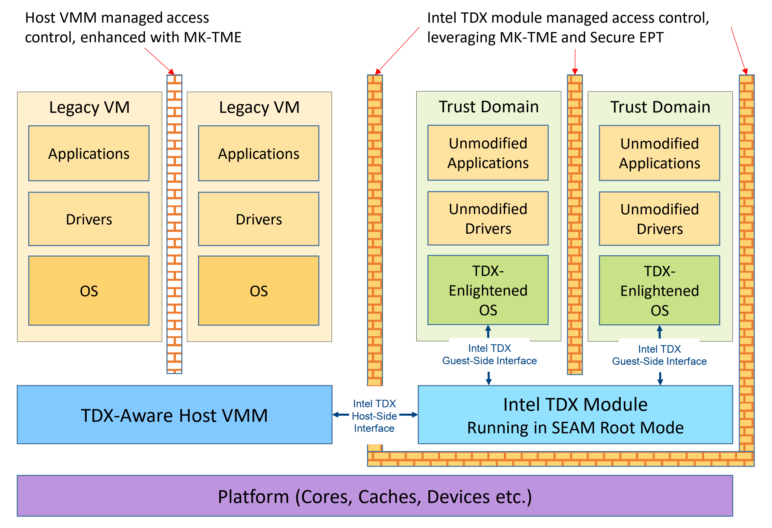
What is TDX?
Trust Domain Extensions (TDX) refers to an extended Virtual Machines Extensions (VMX) and Multi-Key Total Memory Encryption (MKTME) with a new kind of virtual machine guest called a Trust Domain (TD).
﻿The platform is managed by a TDX-aware host VMM. a host VMM can launch and manage both guest TDs and legacy guest VMs.
The host VMM maintains all legacy functionality from the legacy VMs’ perspective; it is restricted only with regard to the TDs it manages.

Slide 3
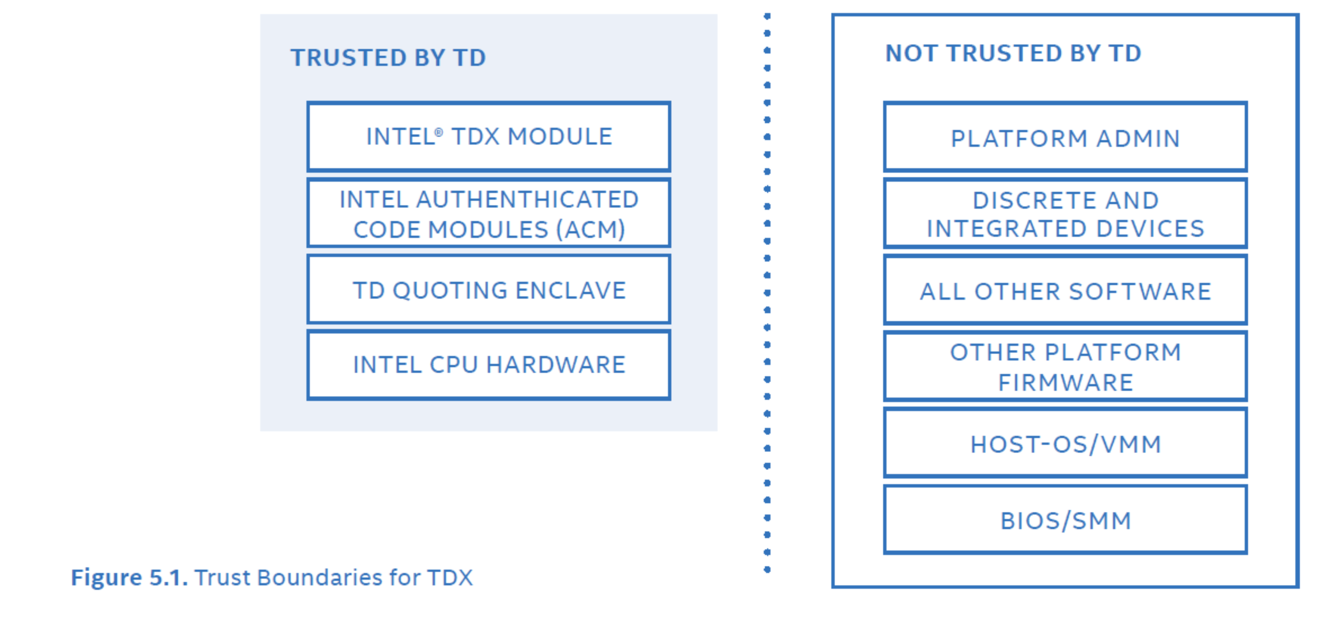
Trust boundaries of TDX
﻿A TD runs in a CPU mode that is designed to protect the confidentiality of its memory contents and its CPU state from any other software, including the hosting Virtual Machine Monitor (VMM), unless explicitly shared by the TD itself.

Slide 4
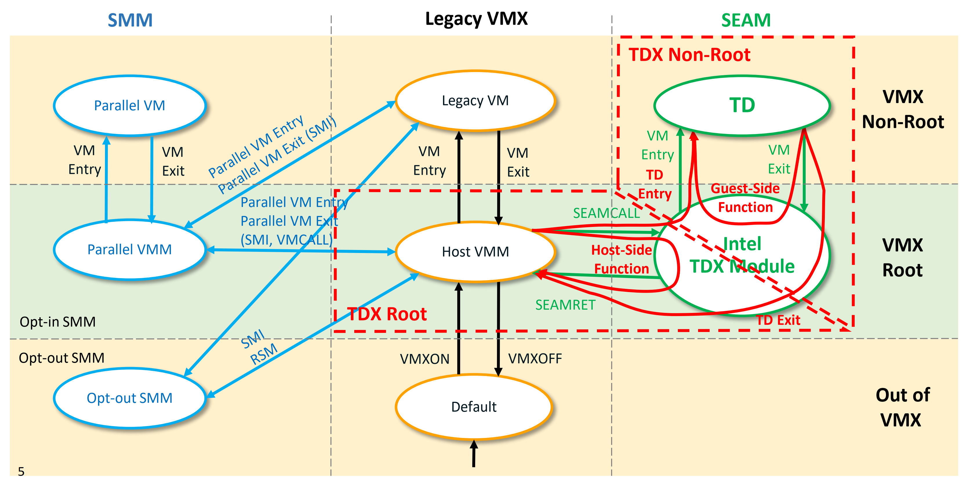
New CPU mode for TDX
SEAM mode (physical): TDX modules run as SEAM mode privilege. The module Host an Intel-provided, digitally signed, but not encrypted, security-services module.
TDX Root Mode and TDX Non-Root Model: Two main new logical modes of operation built upon the new SEAM root and non-root CPU modes added to the Intel VMX architecture

Slide 5
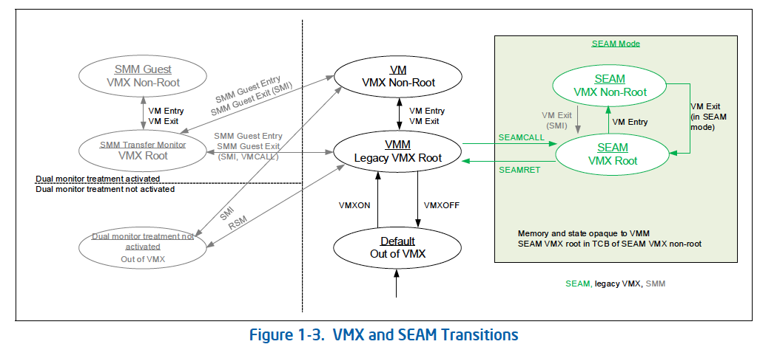
SEAM Mode details
﻿SEAM VMX root operation is designed to host TDX module to manage Trust Domains (TD).
TDX module implements the functions to build, tear down, and start execution of TD VMs.
The VMRESUME/VMLAUNCH instructions are used to help transition to the SEAM VMX non-root operation from SEAM VMX root operation.
VM exits are designed to exit from the SEAM VMX non-root transition to SEAM VMX root operation.

Slide 6
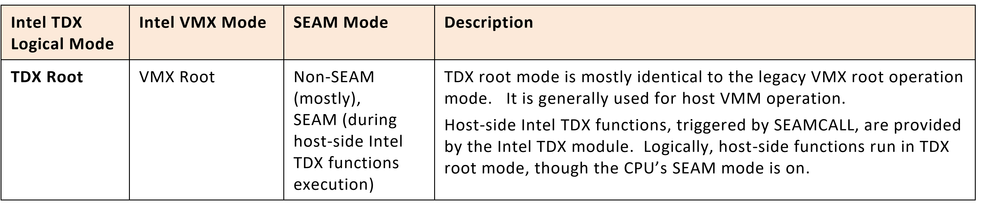
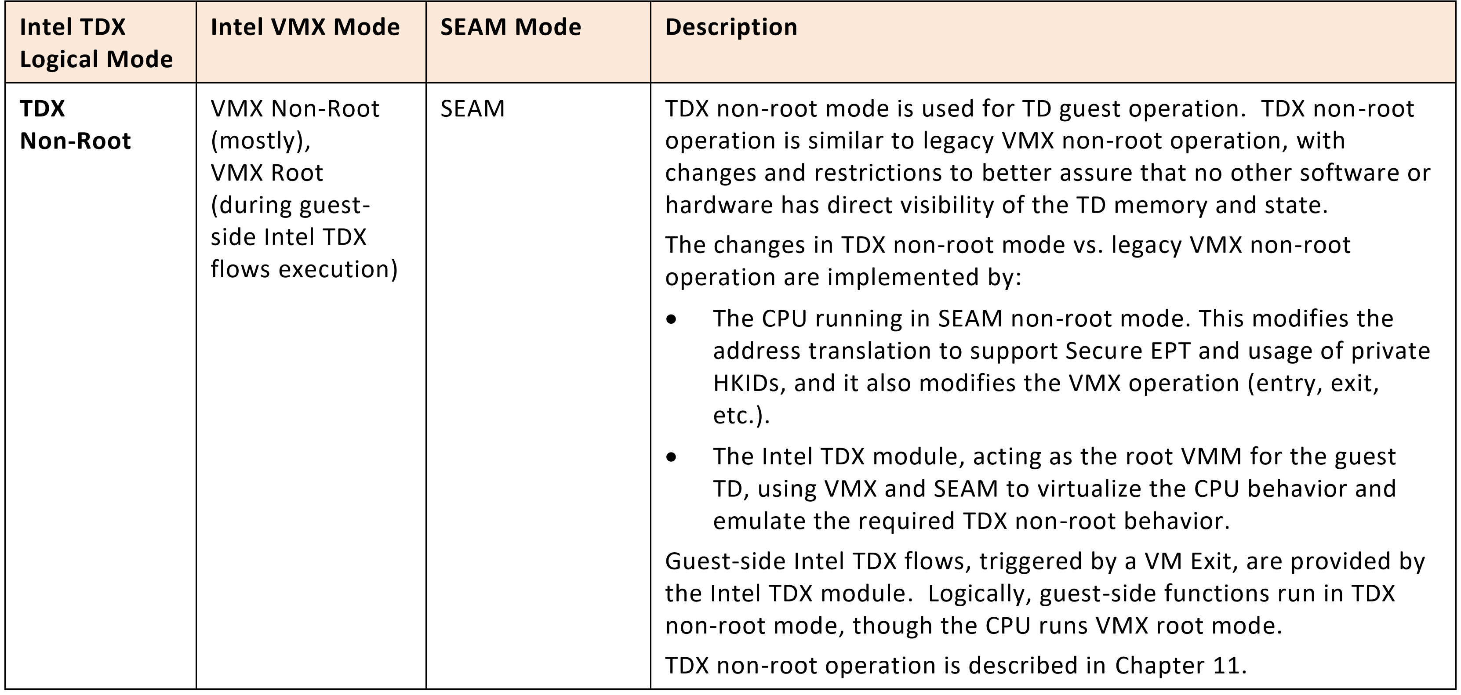
Two logical modes of Intel TDX
TDX transitions between TDX root operation and TDX non-root operation include TD Entries, from TDX root to TDX non-root mode, and TD Exits from TDX non-root to TDX root mode.
A TD Exit might be asynchronous, triggered by some external event (e.g., external interrupt or SMI) or an exception, or it might be synchronous, triggered by TDCALL(TDG.VP.VMCALL) function

Slide 7
TDX transitions
﻿TDX transitions between TDX root operation and TDX non-root
TD Entries, from TDX root to TDX non-root mode
TD Exits from TDX non-root to TDX root mode.
A TD Exit might be asynchronous, triggered by some external event (e.g., external interrupt or SMI) or an exception, or it might be synchronous, triggered by a TDCALL(TDG.VP.VMCALL) function.

Slide 8
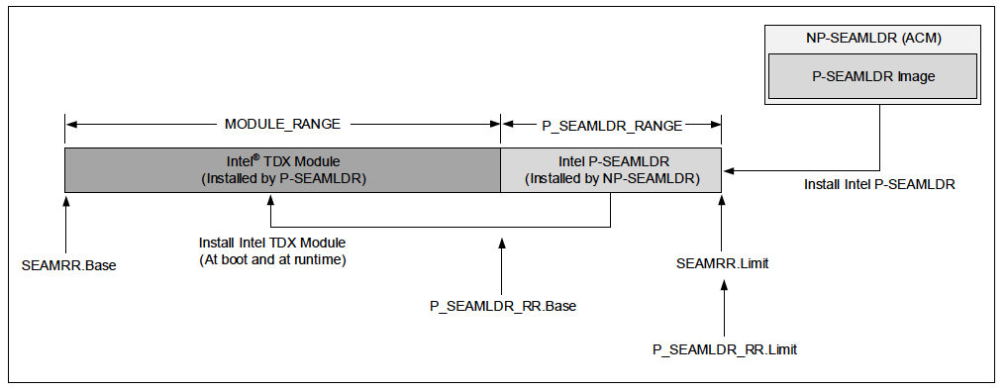
What is TDX module and how to load it?
Intel® TXT authenticated code module (ACM) verifies the digital signature on the Intel Persistent SEAM loader (P-SEAMLDR) module and load it into the SEAM-memory range, P_SEAMLDR_RANGE
P-SEAMLDR module measure, verify, and install the Intel TDX-module into the MODULE_RANGE.
Intel TDX-module provides functions to build and manage TD VMs.

Slide 9
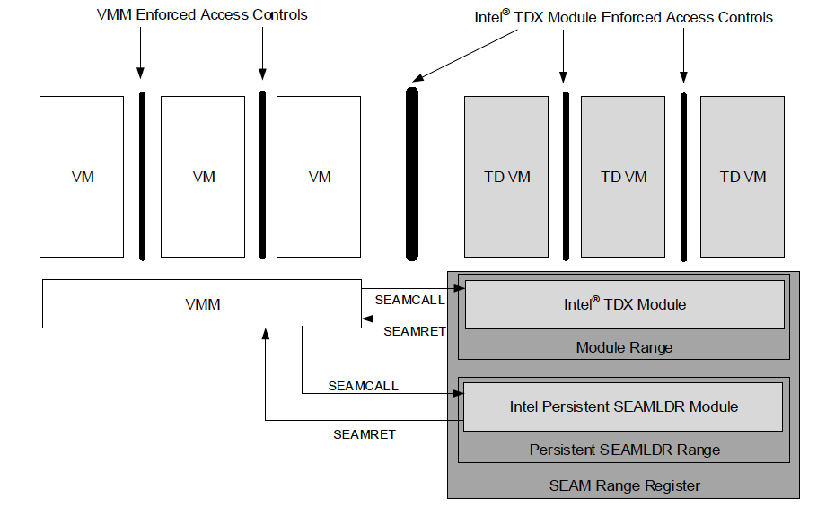
VMM interactions with TDXs
SEAM VMX root operation is designed to additionally host a CPU-attested, software module called the Intel Persistent SEAMLDR (Intel P-SEAMLDR) module to load and update the Intel TDX module
The Intel TDX module and the Intel P-SEAMLDR module, that execute in SEAM VMX-root operation, execute out of memory defined by the SEAM range register (SEAMRR)
Currently, the Intel TDX Module is the only SEAM module that the Intel P-SEAMLDR installs.

Slide 10
VMM <-> TDX module <-> TD
﻿SEAMCALL
The instruction used by the host VMM to invoke host-side TDX interface functions.
Transitions from legacy VMX-root operation to SEAM VMX-root
The desired interface function is selected by an input operand (leaf number, in RAX).
Host-side interface function names start with TDH (Trust Domain Host).
TDCALL
The instruction used by the guest TD software (in TDX non-root mode) to invoke guest-side TDX functions.
The desired interface function is selected by an input operand (leaf number, in RAX).
Guest-side interface function names start with TDG (Trust Domain Guest)
The processor transitions out of SEAM VMX-root operation to legacy VMX-root operation in response to a SEAMRET instruction.

Slide 11
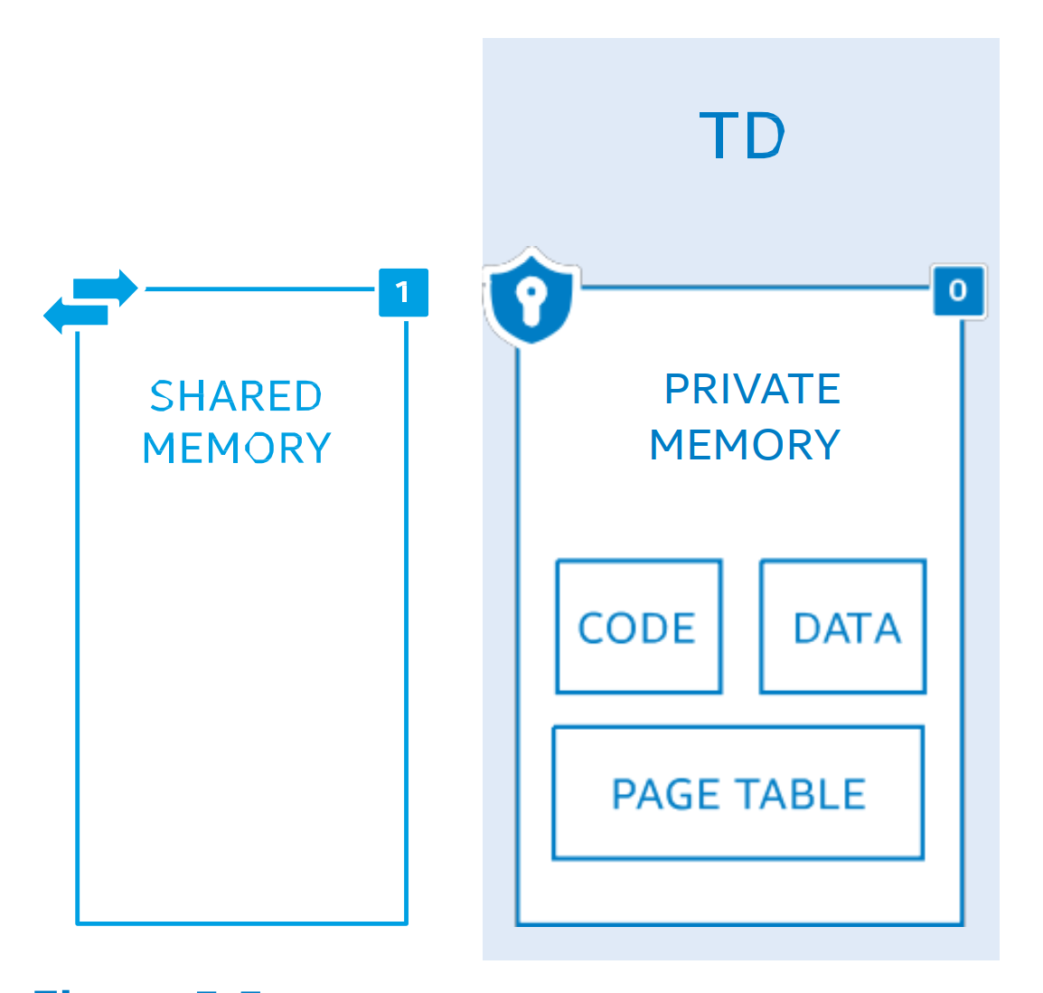
TD private memory / shared memory
﻿TDs have access to two classes of memory
﻿private memory holding the confidential data of the TD
ephemeral-memory-encryption key assigned to that TD
shared memory communicating with untrusted entities external
to perform I/O operations such as network access, storage services, invoking hypervisor services
Private memory + TD assigned private key
GPA with “Shared” bit set to 0
helps encrypt and integrity-protect all memory accesses t
Shared memory + Hypervisor shared key
GPA with “Shared” bit set to 1
may be encrypted and integrity protected with the aid of a shared key
hypervisor manages the shared key

Slide 12
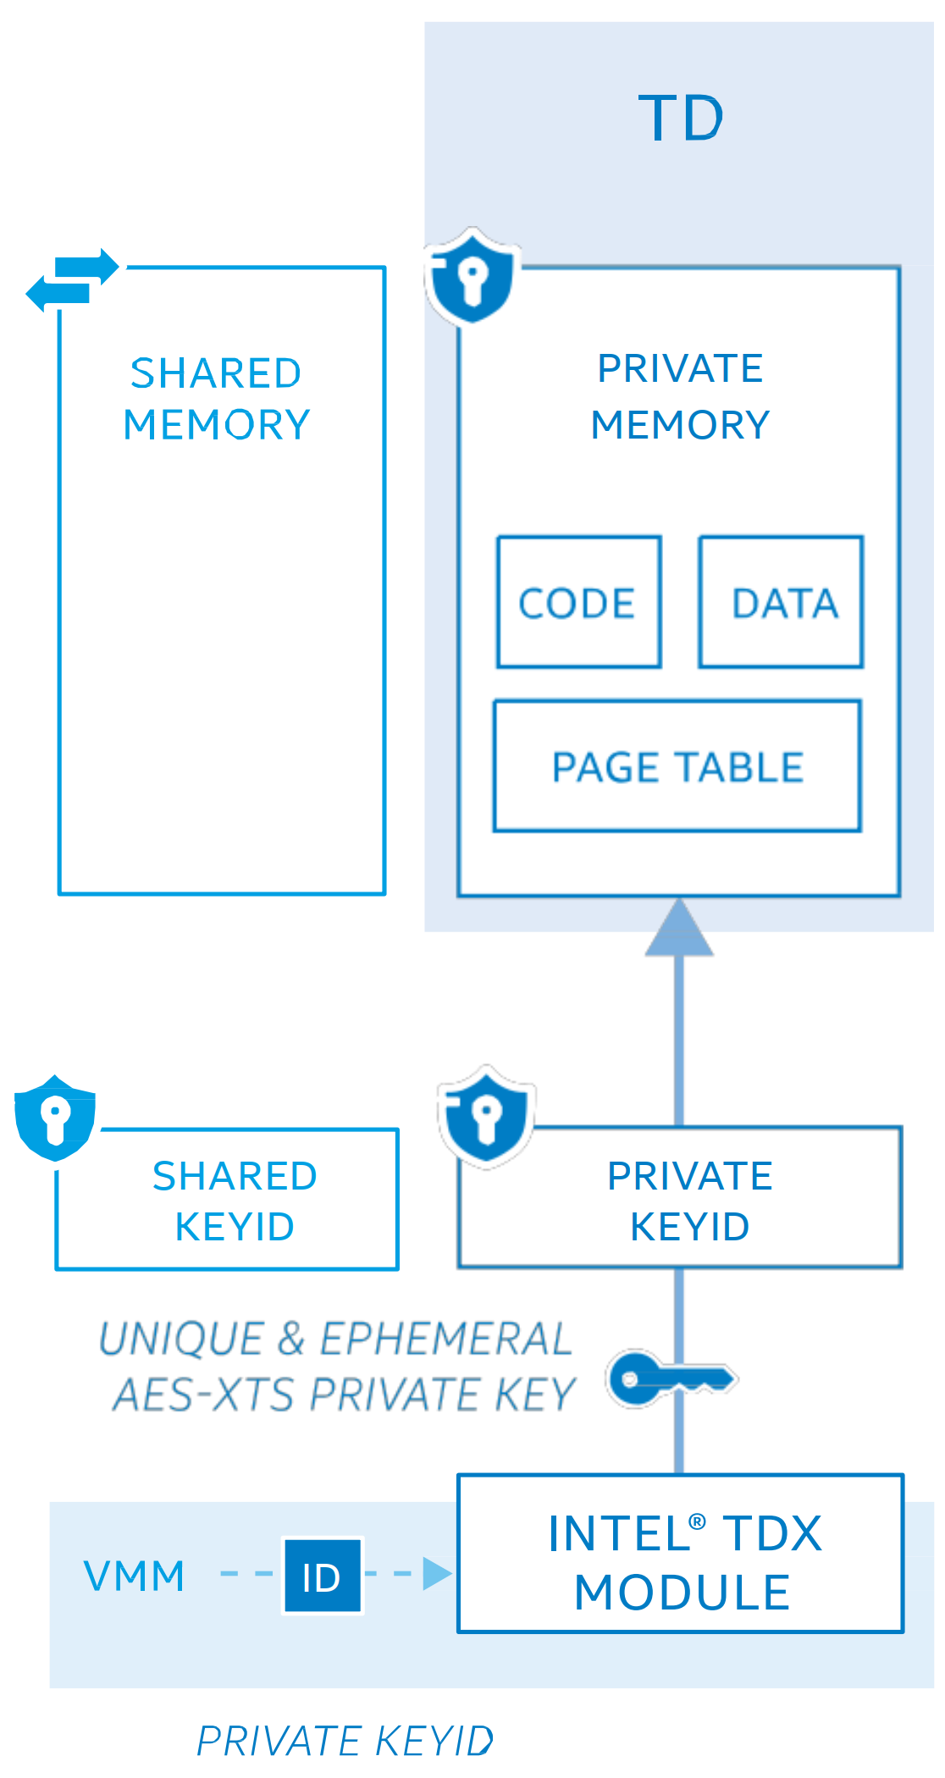
MKTME keys and TDX
﻿The set of KeyID(s) of MKTME can be partitioned into two groups
private KeyID(s) and Shared KeyID(s)
﻿PCONFIG allow private KeyIDs to be programmed (in SEAM mode)
﻿On TD creation, the module is intended to assign each TD a unique, private KeyID
HKID is “stolen” from the top of the host physical address
﻿The CPU is designed to disallow software other than the TDX module and TDs from making memory accesses using a private KeyID
﻿DMA from devices using a private KeyID would be aborted.
﻿The physical address bits reserved for encoding TDX private KeyID are meant to be treated as reserved bits when not in SEAM operation
﻿When translating a guest physical address outside SEAM, if any EPT structure entry has bits reserved for TDX private KeyID encoding in the physical address set, then the processor helps generate an EPT misconfiguration.

Slide 13
TD memory encryption with MTKME
﻿﻿Memory encryption performed by encryption engines residing at memory controller.
﻿encryption engine holds a table of encryption keys, known as the Key Encryption Table (KET).
the key is selected for each memory transaction based on a HKID provided with the transaction.
﻿The host-side Intel TDX functions help provide the means for the host VMM
TDX module use PCONFIG instruction to program a AES-XTS 128 bit key to HKID (at initialization)
host VMM does not have access to the encryption keys.
SHA-3 MAC (28-bit) on each cache line in addition to AES-XTS 128-bit memory
﻿ SHA-3-256 (KECCAK [512]) generates 256 bit MAC => truncated to 28bit
﻿replay of memory via physical access are not detected or protected-against by the current generation of memory protection for Intel TDX

Slide 14
TD memory integrity protection
There are two optional mode for memory integrity
either (the default) cryptographic-integrity protection scheme
Protect the cache with MAC
Utilizing one bit added to each cache line indicating whether the cache line belongs to TD
Note that it doesn’t distinguish who owns the TD memories
I think this integrity protections are for row-hammer like attacks?
logical-integrity protection scheme
Protect the cache without MAC
Only TD bit appended to the cache
Preventing software access to TD ciphertext
By design, when reading a cache line using a KeyID with integrity enabled, if the MAC stored in the metadata does not match the MAC regenerated by the MKTME, then the cache line is marked poisoned to prevent the data from being consumed.
﻿A MAC-verification or a TD-ownership check failure leads to its termination, but other TDs and platform software would not be impacted
Can we utilize this feature for protecting row-hammer? Separating important pages with MAC and unimportant pages with just logical protection?

Slide 15
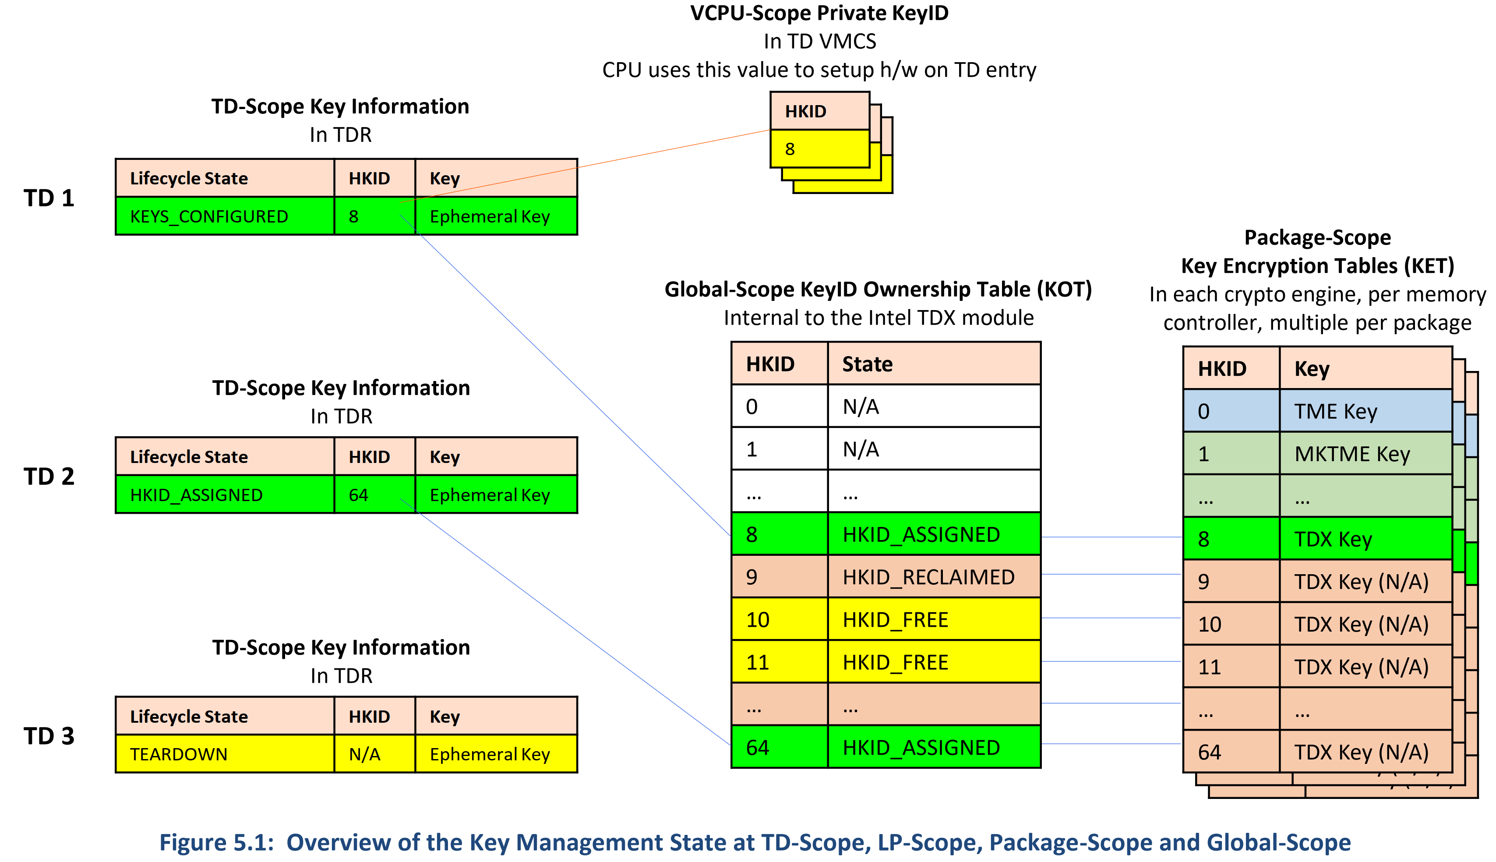

Slide 16
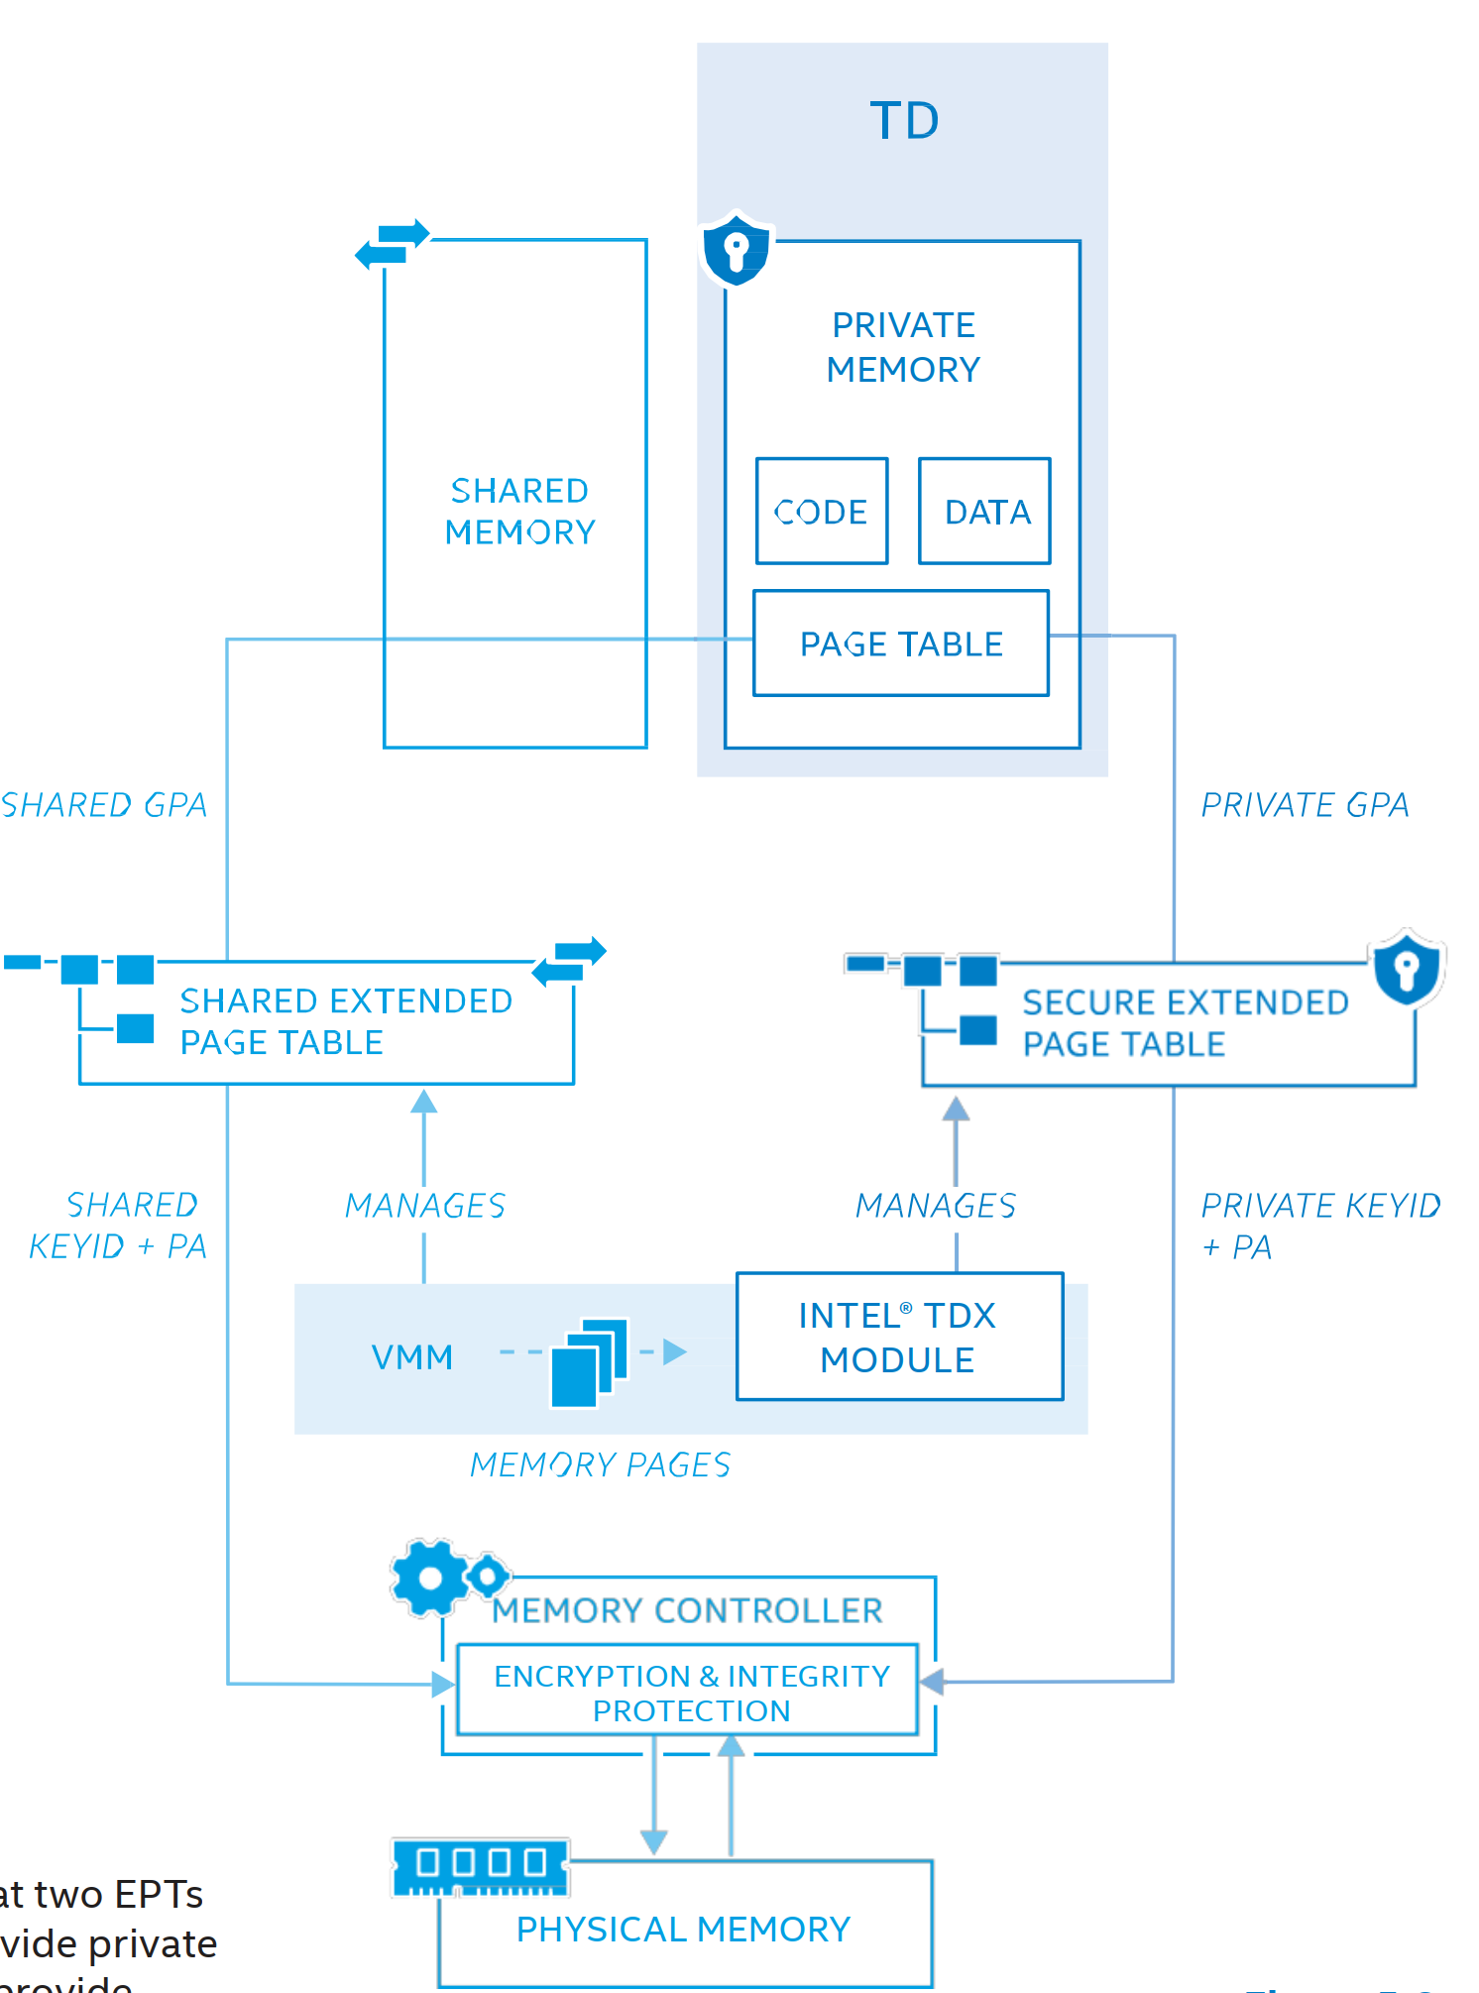
﻿ADDRESS-TRANSLATION INTEGRITY
CPU translates shared GPAs using Shared EPT, which resides in host VMM memory.
The Shared EPT is directly managed by the host VMM – the same as with legacy VMX.
﻿CPU translates private GPAs using a separate Secure EPT.
Managed by TDX module, and the VMM should request TDX to modify secure EPT pages
Secure EPT is designed to be encrypted and integrity protected using the unique, per-TD, memory-encryption key.
﻿The CPU prevent a TD from locating page-table structures and executable code in shared memory.
CPU would cause a page fault (#PF) on code fetches or pagetable accesses if they are in shared memory
﻿At the end of translation, the CPU sets the HKID bits in the HPA to the TD’s assigned HKID

Slide 17
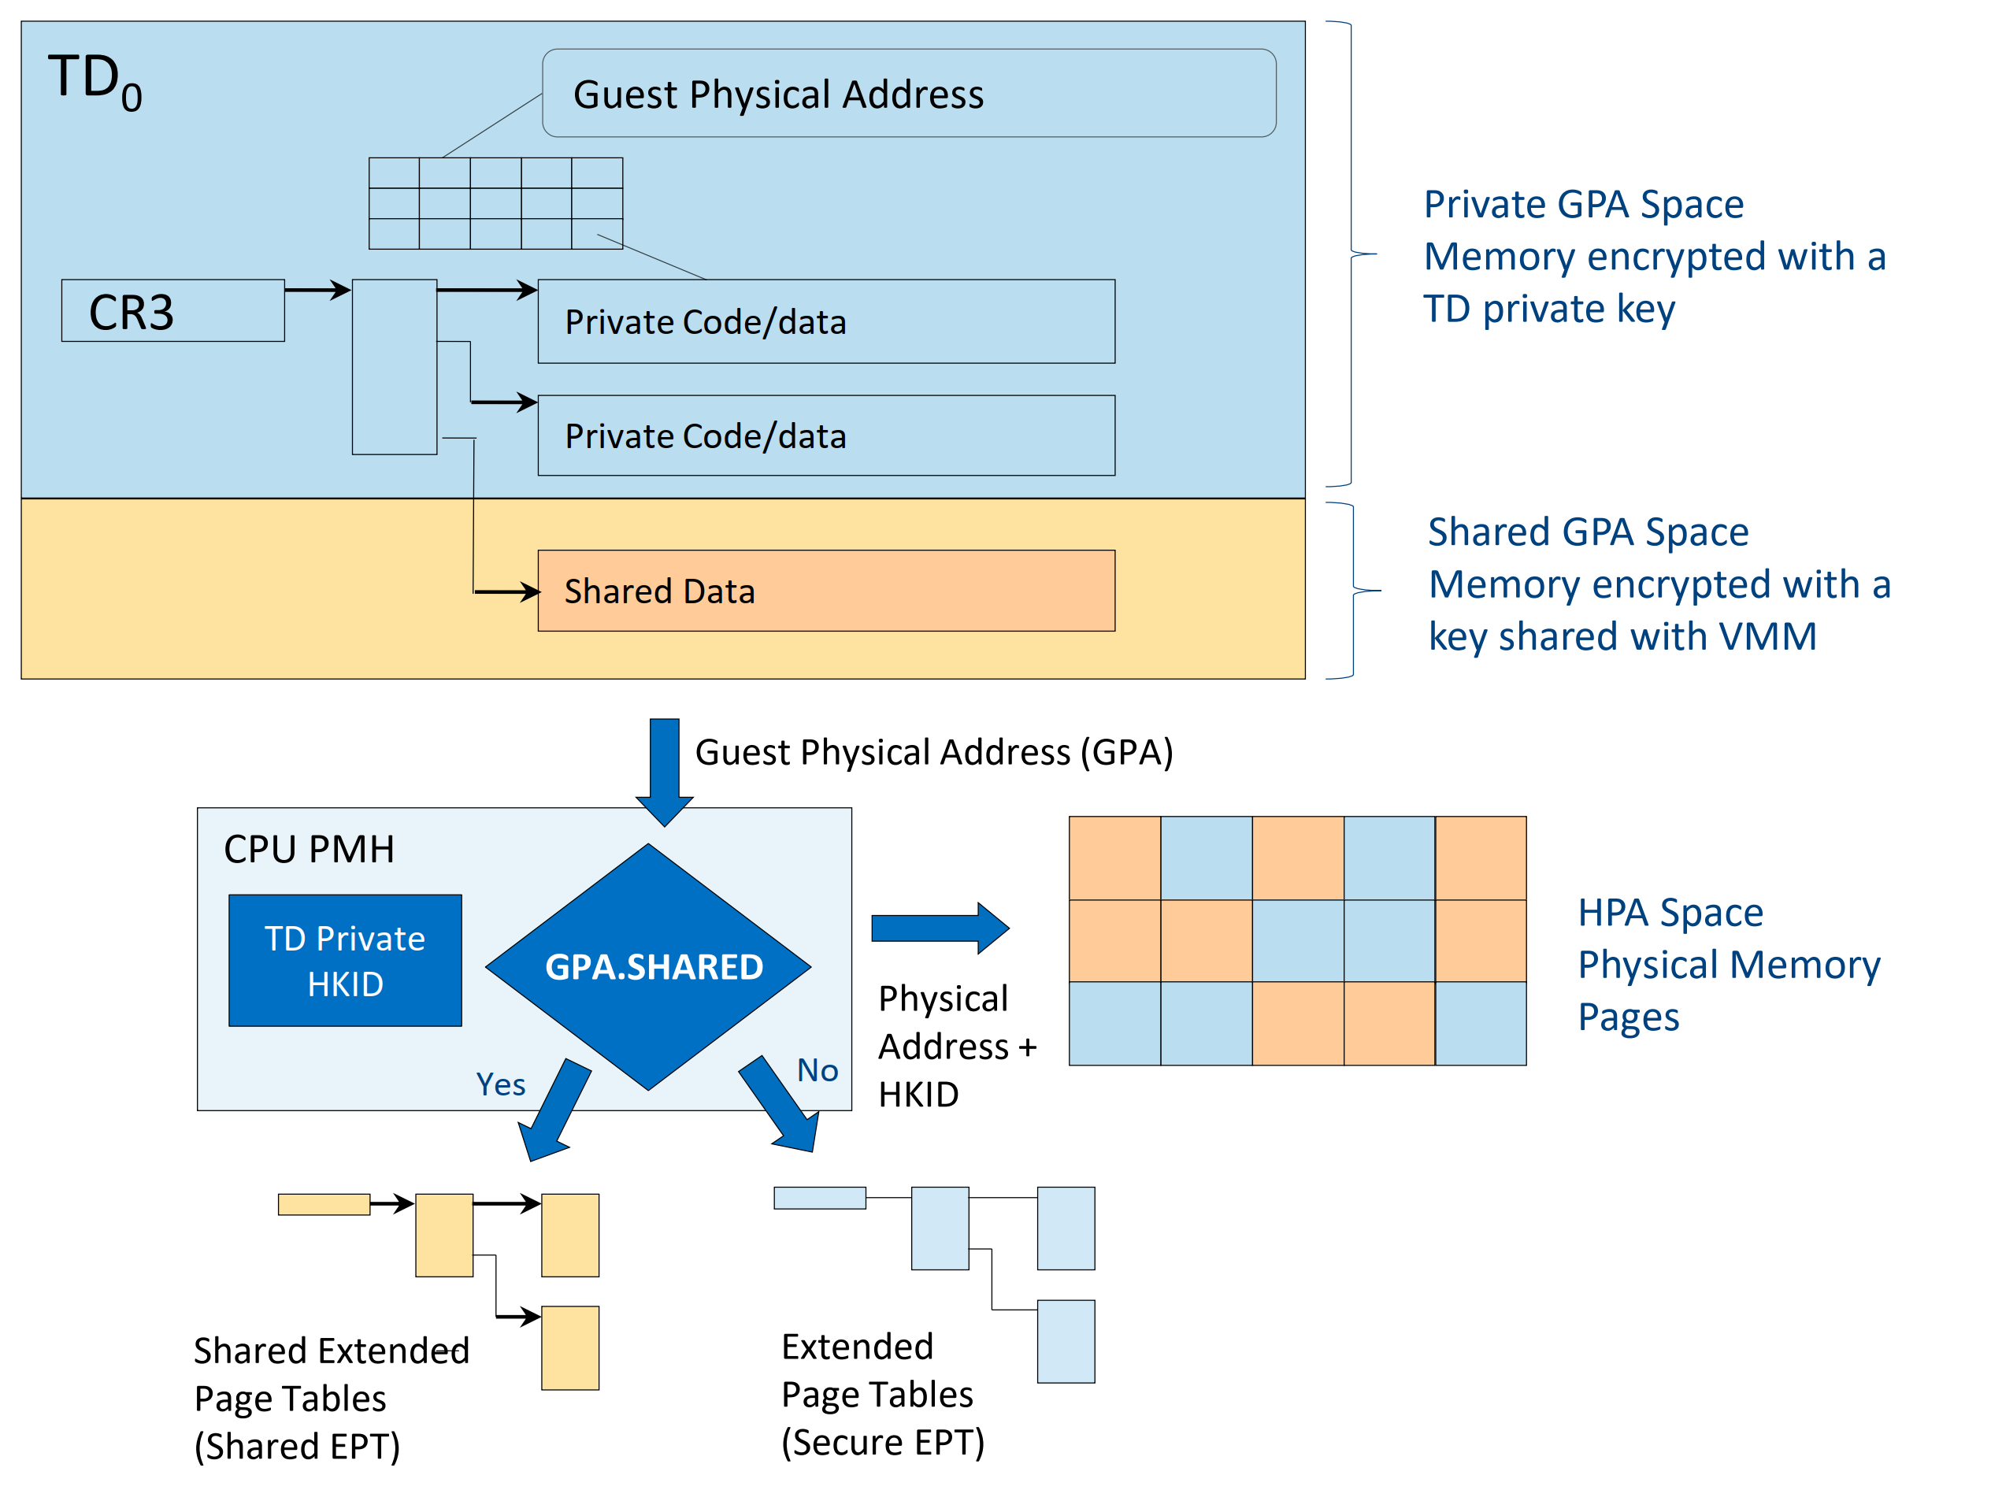
PMH checks the GPA and associates with EPTs
PMH is involved before the EPT pagetable walking to distinguish GPA is shared or private
﻿Physical-Address-Metadata Table(PAMT)
A page mapped into the secure-EPT of one TD cannot be mapped into secure EPT of any other TD.
help map a page to only one GPA in the secure EPT
track the page sizes and page types in the PAMT to track the correctness of the secure-EPT operations
Support invalidations of TLB entries when a page is unmapped from the secure EPT.

Slide 18
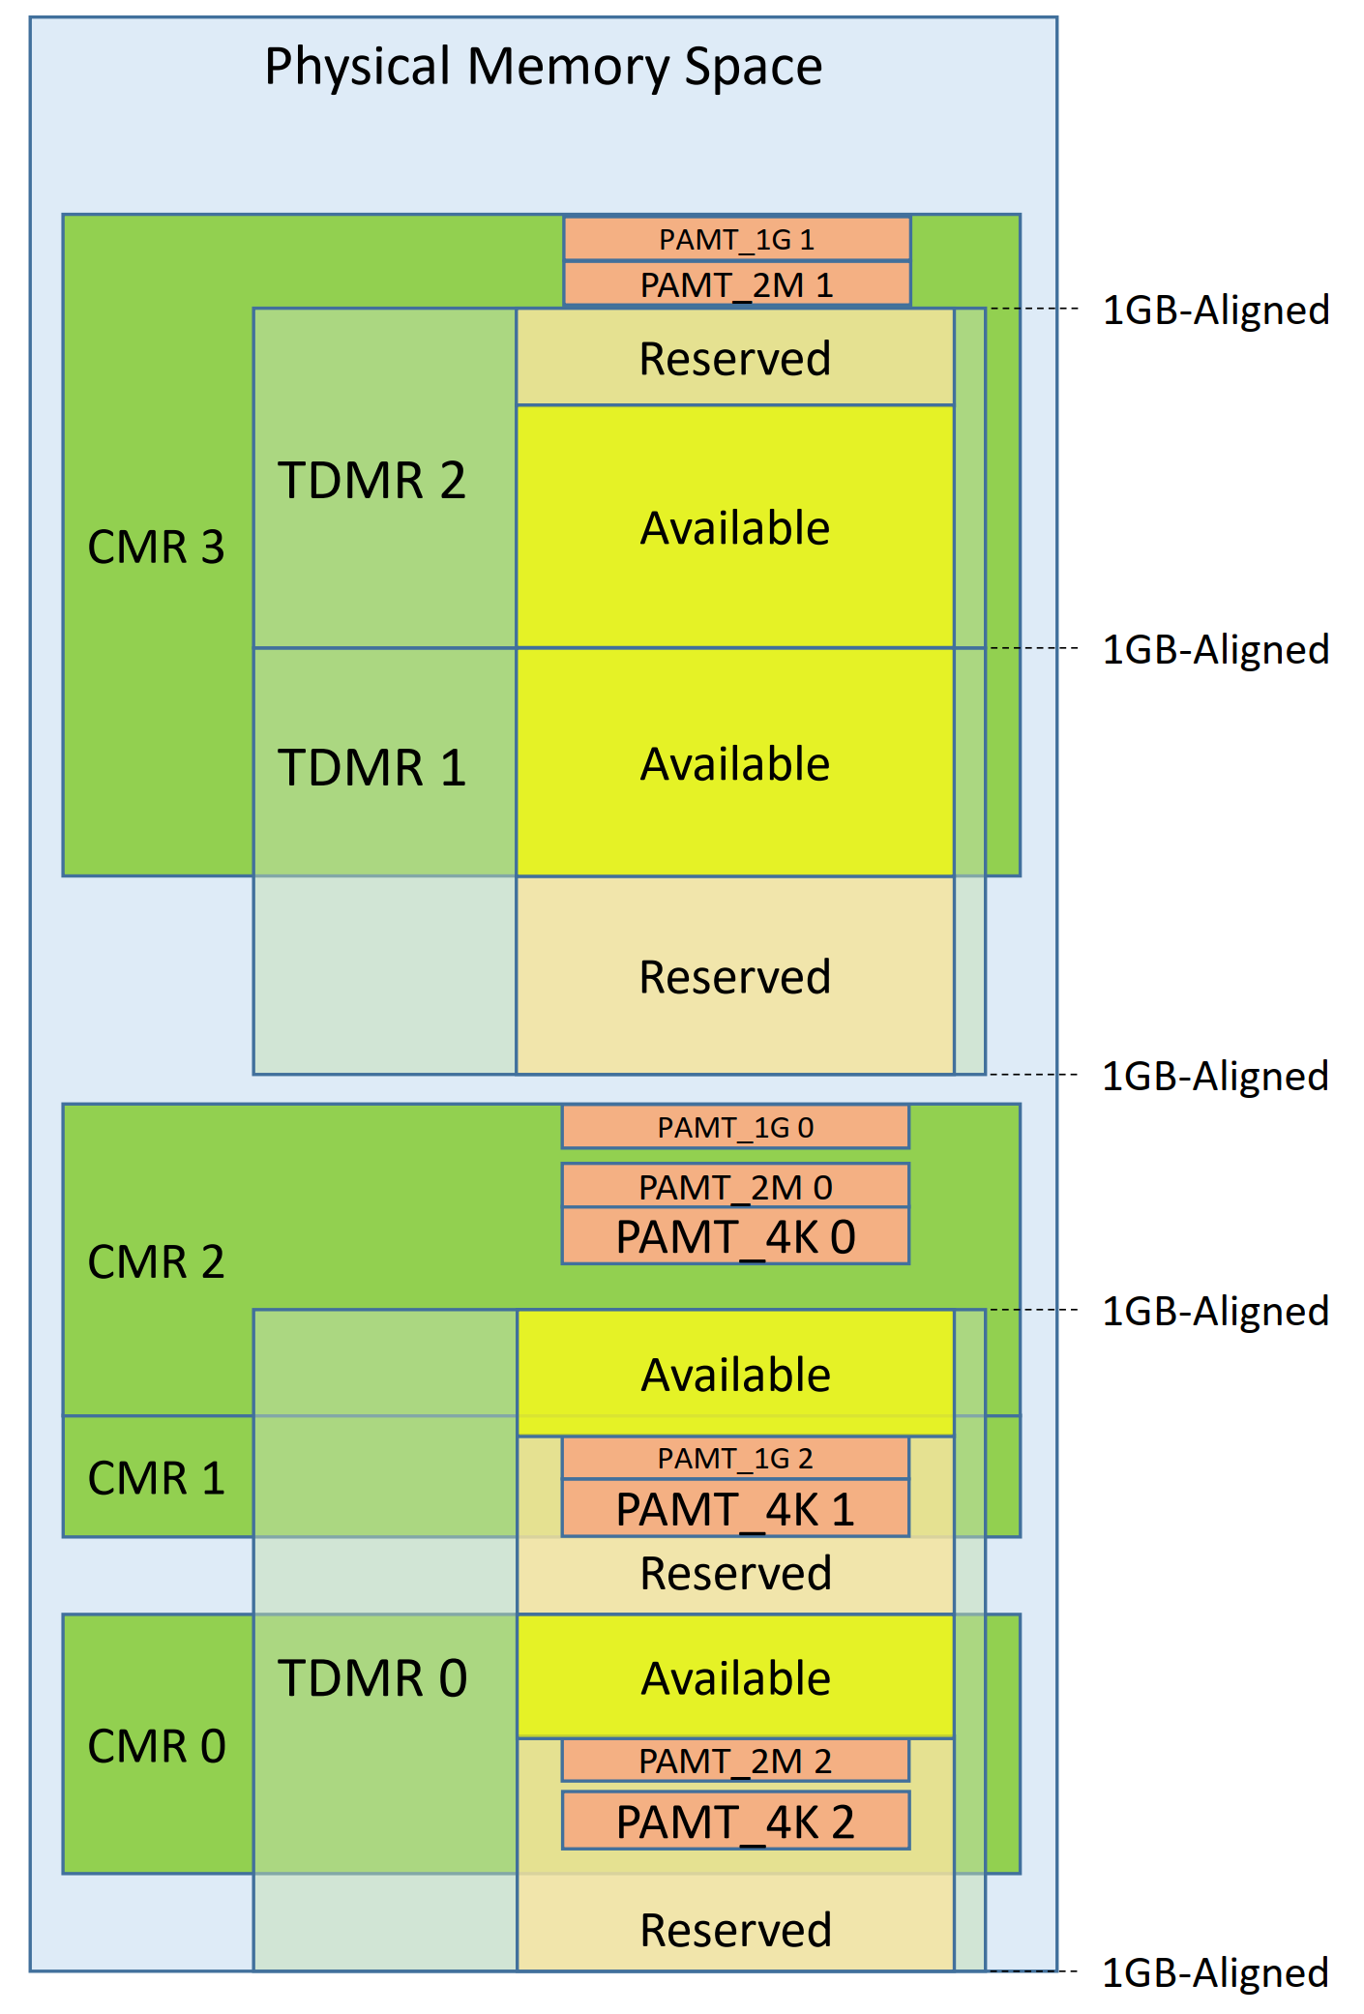
Physical memory view of TDX
﻿﻿Convertible Memory Ranges (CMR): A range of physical memory that can hold TD-private memory pages configured by BIOS and verified by MCHECK. MCHECK verification ensure that a CMR can hold TDX memory pages encrypted with a private HKID (every content in CMR region is encrypted)
﻿﻿Trust Domain Memory Range (TDMR): A range of memory, configured by the host VMM, that is covered by PAMT and is intended to hold TD private memory and TD control structures (﻿1GB page becomes available for use by any Intel TDX function that creates a private TD page or a control structure page – e.g., TDH.MEM.PAGE.ADD, TDH.VP.ADDCX, etc.)
﻿The Physical Address Metadata Table (PAMT): track the metadata of every physical page in TDMR. A page metadata includes page type, page size, assignment to a TD, and other attributes
All regions are software configured (no hardware registers?)

Slide 19
TDMR and PAMT
TDMR granularity must be 1GB.
﻿However, there is a requirement for the host VMM to be able to allocate memory at granularities smaller than 1GB
TDX module allows arbitrary reserved areas within TDMRs (Reserved areas are still covered by PAMT)
However, during initialization their respective PAMT entries are marked with a PT_RSVD page type, so pages in reserved areas are not used by the Intel TDX module for allocating privately encrypted memory pages (but they can be used for PAMT areas)
TDX supports 3 page sizes: 4K, 2M, and 1G. Each "TD Memory Region" (TDMR) has 3 PAMTs to track the 3 supported page sizes respectively.
However, the PAMTs which track pages in one TDMR do not need to reside within that TDMR but can be anywhere in CMRs.
If one PAMT overlaps with any TDMR, the overlapping part must be reported as a reserved area in that particular TDMR
Cannot understand why reserved area allows TDX split 1G page into 4k, 2m, 1G with PAMT..?

Slide 20
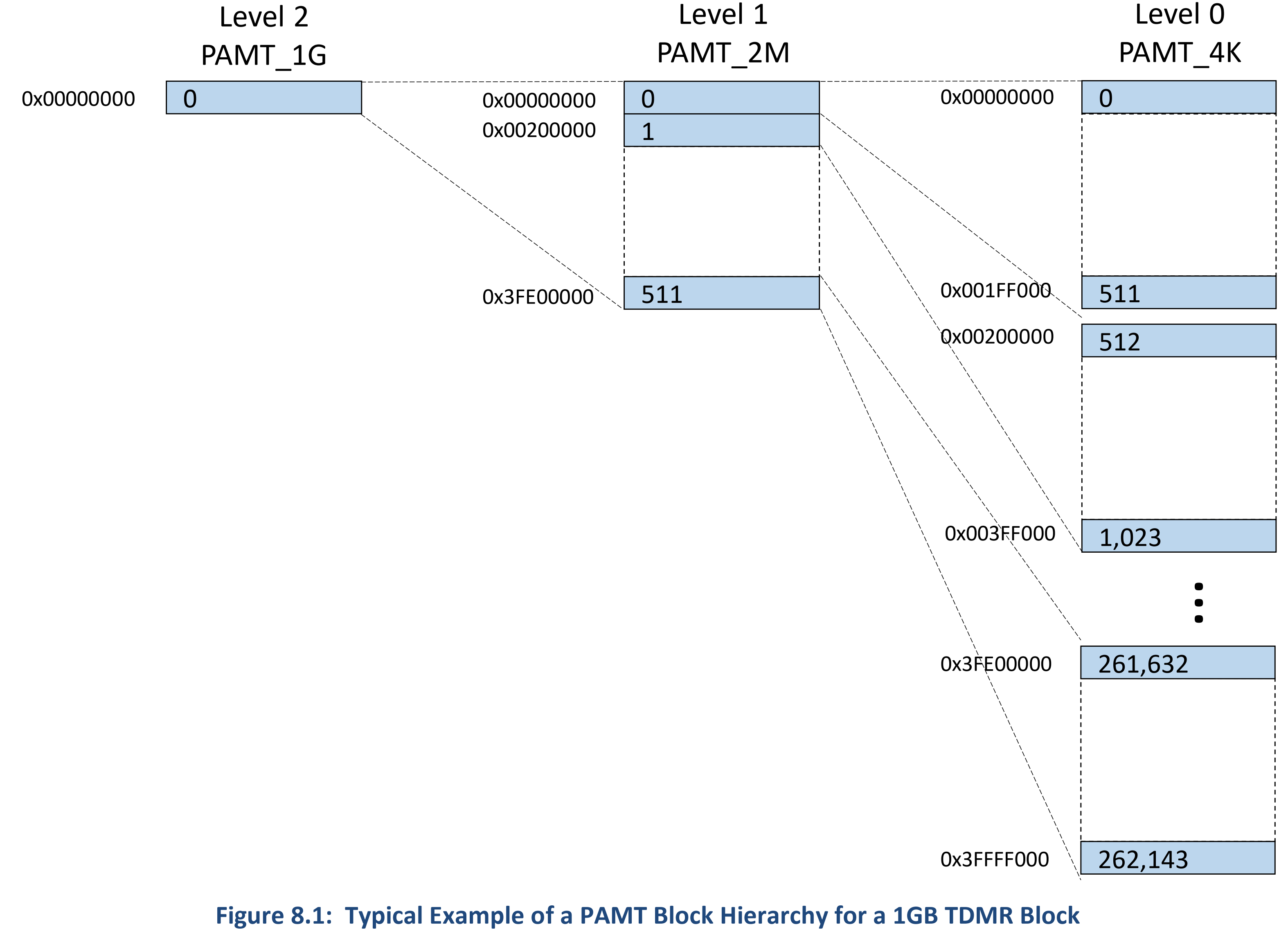
TDMR and PAMT
PAMT essentially serves as the 'struct page' for the TDX module. PAMTs are not reserved by hardware upfront. They must be allocated by the kernel and then given to the TDX module.
PAMT properties﻿
Single TD Assignment: A physical page in TDMR can be assigned to at most one TD.
Secure EPT Consistency: The page size of any private TD page, mapped in Secure EPT, matches its page size attribute in PAMT.﻿
for each TDMR the design includes three arrays of PAMT entries, one for each PAMT level (Level 0-2, 4K-1G)

Slide 21
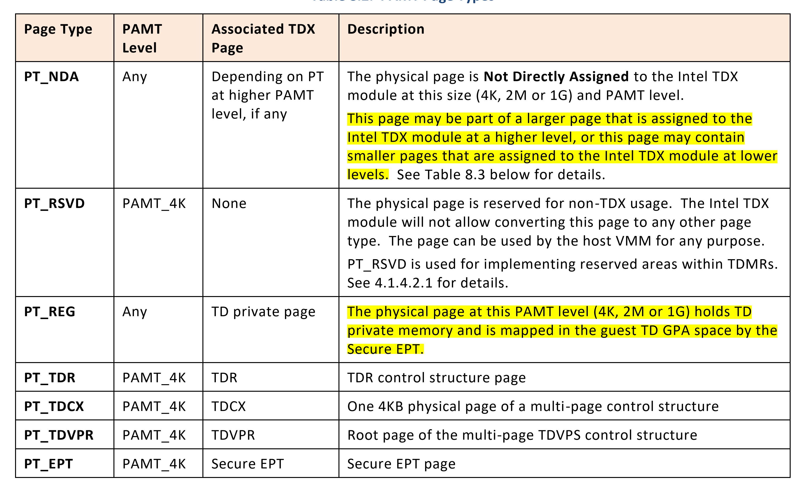
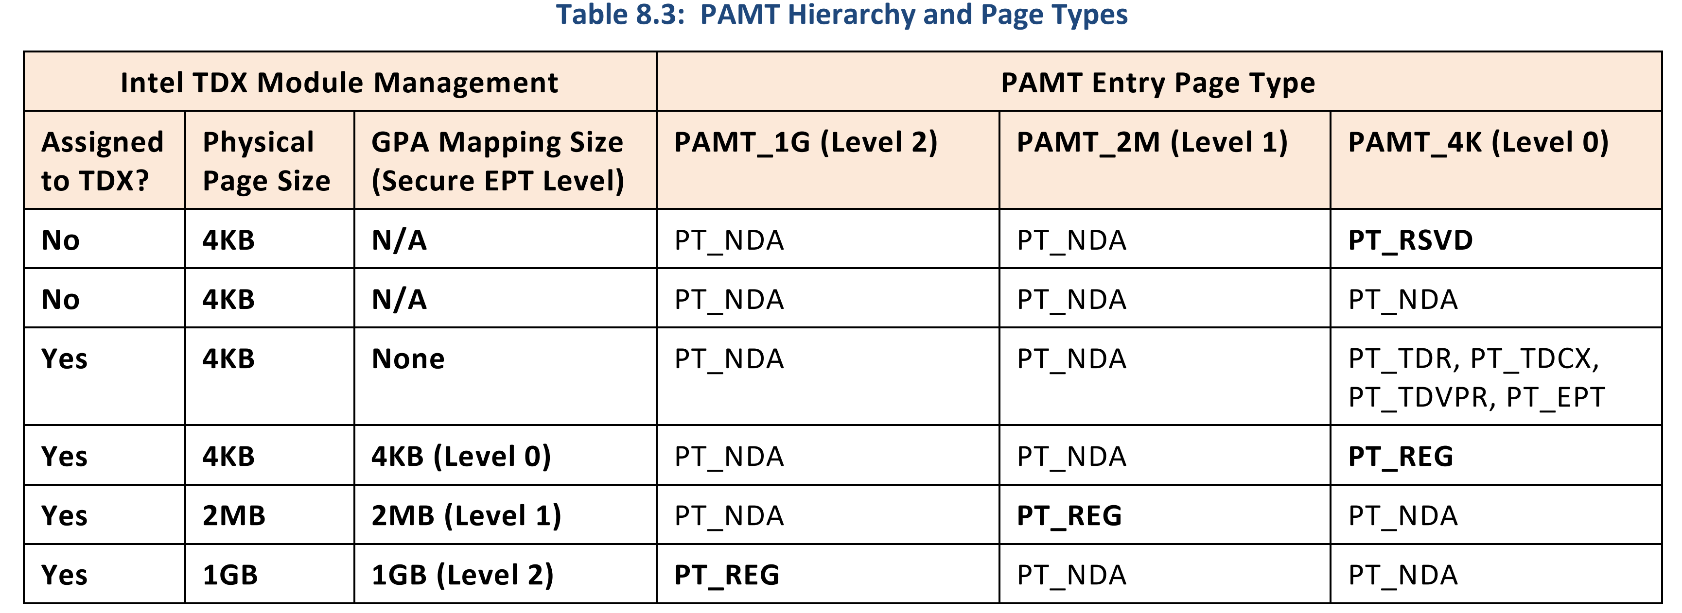
PAMT page type

Slide 22
﻿Intel TDX Managed Control Structures
﻿ Intel TDX module holds and manages a set of control structures that are not directly accessible to software (except the Intel TDX module itself).
The controls structures are encrypted with private keys and HKIDs, and their content is only accessible in SEAM mode.
TDX module uses control structures to manage
TD-private memory
transitions into and out of TDX non root operation (TD entries and TD exits)
processor behavior in TDX non-root operation

Slide 23
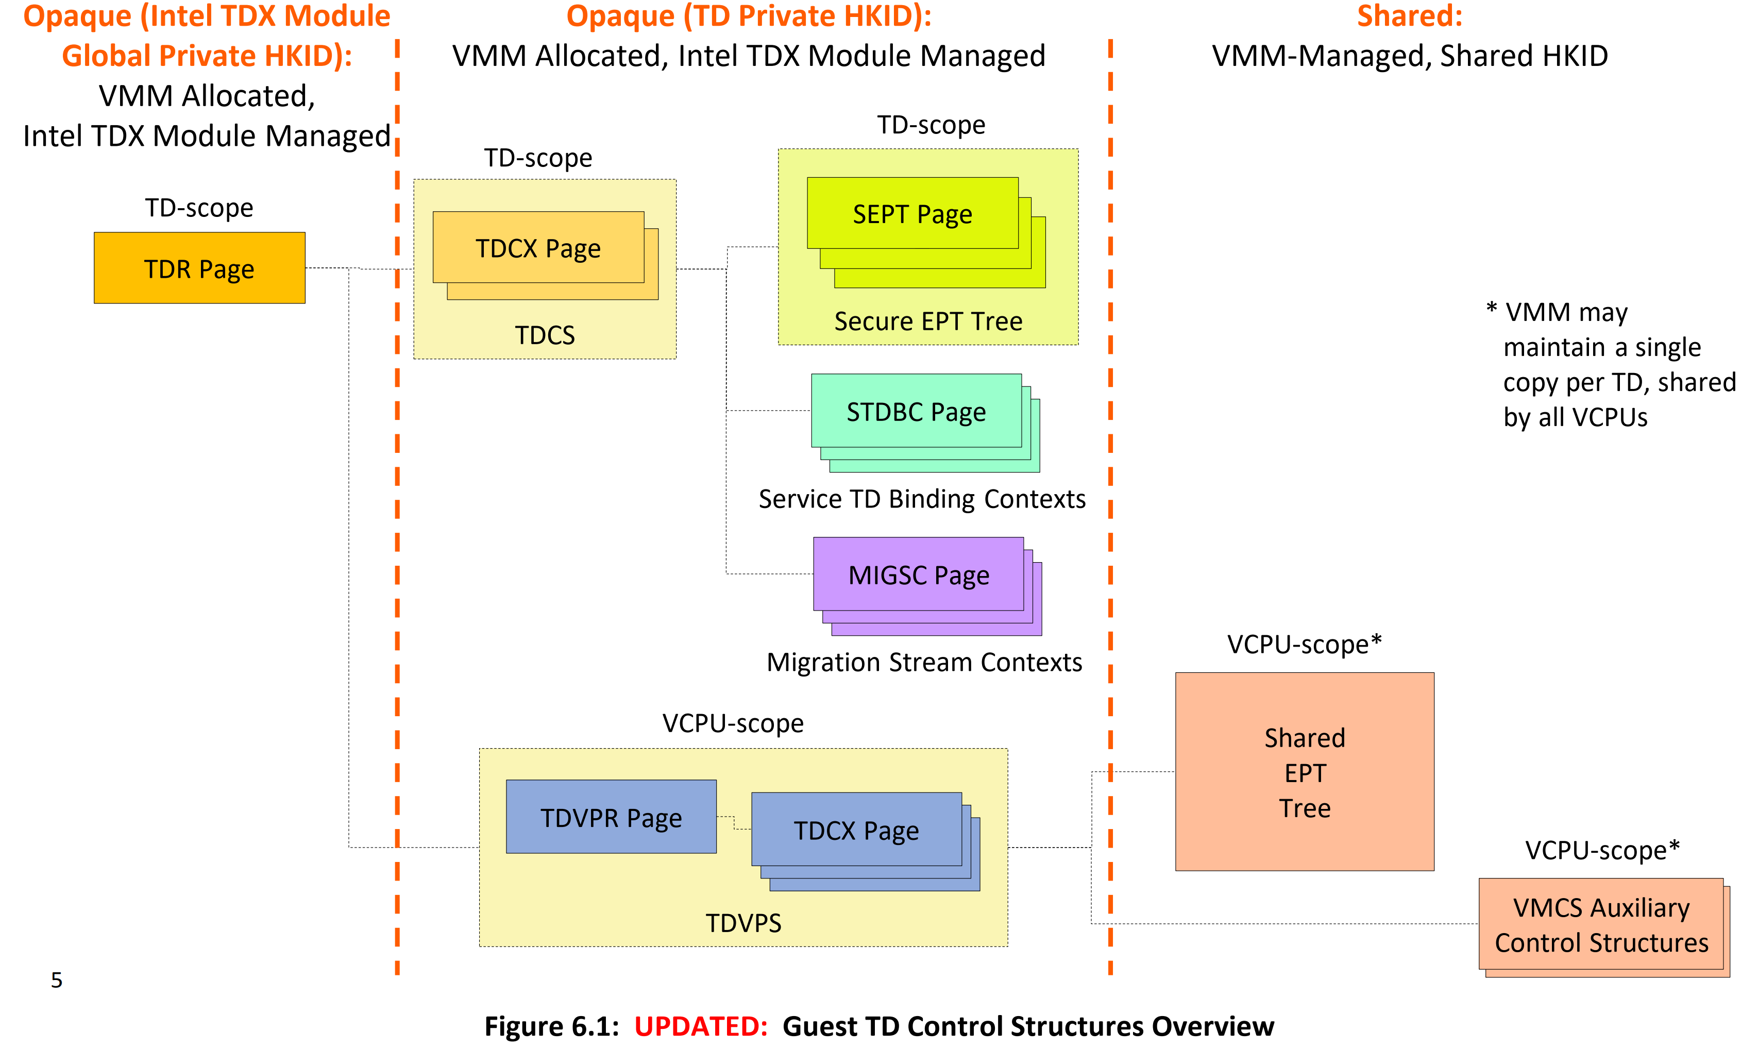
﻿TD Non-Memory State and Control Structures
﻿Shared control structures are intended to be directly managed by the host VMM and are encrypted with a shared HKID.
Opaque control structures are not intended to be directly accessible to any software (except the Intel TDX module) or DMA. They are intended to be managed via Intel TDX module functions.
Generally speaking, the host VMM is not aware of the exact format of opaque control structures. Opaque control structures’ memory pages are intended to be encrypted with a private HKID.

Slide 24
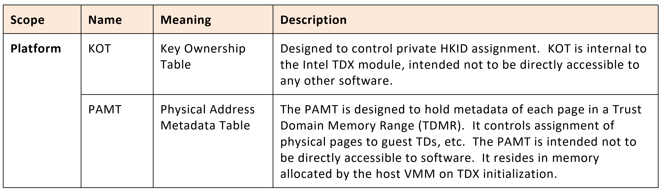
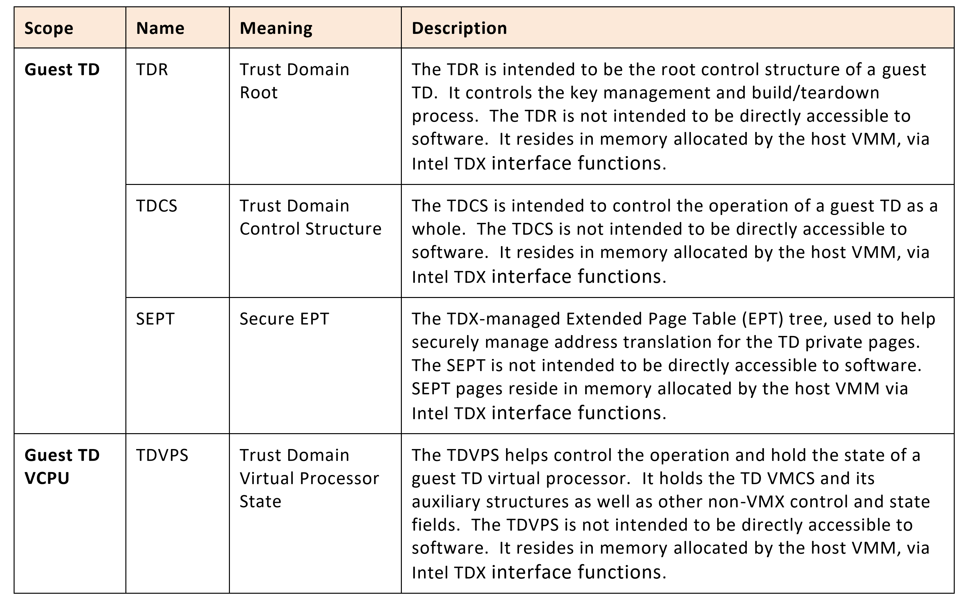
﻿Intel TDX Managed Control Structures
﻿TDX module holds and manages a set of control structures that are not directly accessible to software (except the Intel TDX module itself).
The controls structures are encrypted with private keys and HKIDs, and their content is only accessible in SEAM mode
﻿control structures to help manage TD-private memory, transitions into and out of TDX nonroot operation (TD entries and TD exits), as well as processor behavior in TDX non-root operation.

Slide 25
Important data structures for TD
﻿The TDR, root control structure of a guest TD. It controls the key management and build/teardown process.
﻿The TDCS controls the operation of a guest TD (﻿TDCS is the main control structure of a guest TD)
The TDCX is ﻿4KB physical pages that are intended to hold parts of a multi-page control structure (all TD opaque data are stored in TDCX pages)
﻿SEPT, the TDX-managed Extended Page Table (EPT) tree, used to help securely manage address translation for the TD private pages.
The TDVPS helps control the operation and hold the state of a guest TD virtual processor. It holds the TD VMCS and its auxiliary structures as well as other non-VMX control and state fields.
All data structures are not intended to be directly accessible to software. It resides in memory allocated by the host VMM, via Intel TDX interface functions.

Slide 26
﻿TDR (Trust Domain Root)
﻿TDR is the root control structure of a guest TD.
At a high level.
﻿control guest TD build and teardown process.
﻿manage memory encryption keys
TDR is encrypted using the Intel TDX global private HKID.
It holds a minimal set of state variables that enable guest TD control even during times when the TD’s private HKID is not known, or when the TD’s key management state does not permit access to memory encrypted using the TD’s private key
﻿Its physical address serves as a unique identifier of the TD, as long as any TD page or control structure resides in memory

Slide 27
﻿TDCS (Trust Domain Control Structure)
﻿TDCS is the main control structure of a guest TD.
TDCS is encrypted using the guest TD’s ephemeral private key.
TDCS is logical structure composed of TDCX physical pages
TDCS might have below fields..
﻿Fields designed to control the TD operation (e.g., a counter of the number of VCPUs currently running).
Fields designed to control the TD’s execution control (debuggability, CPU features available to the TD, etc.).
Fields related to TD measurement.
EPTP: as designed, a pointer (HPA) to the TD’s secure EPT root page and EPT attributes.
MSR bitmaps, designed to be used by all the TD’s VCPUs.
secure EPT root page.
A page filled with zeros, designed to be used in cases where the Intel TDX module needs a read-only constant-0 page encrypted with the TD’s private key

Slide 28
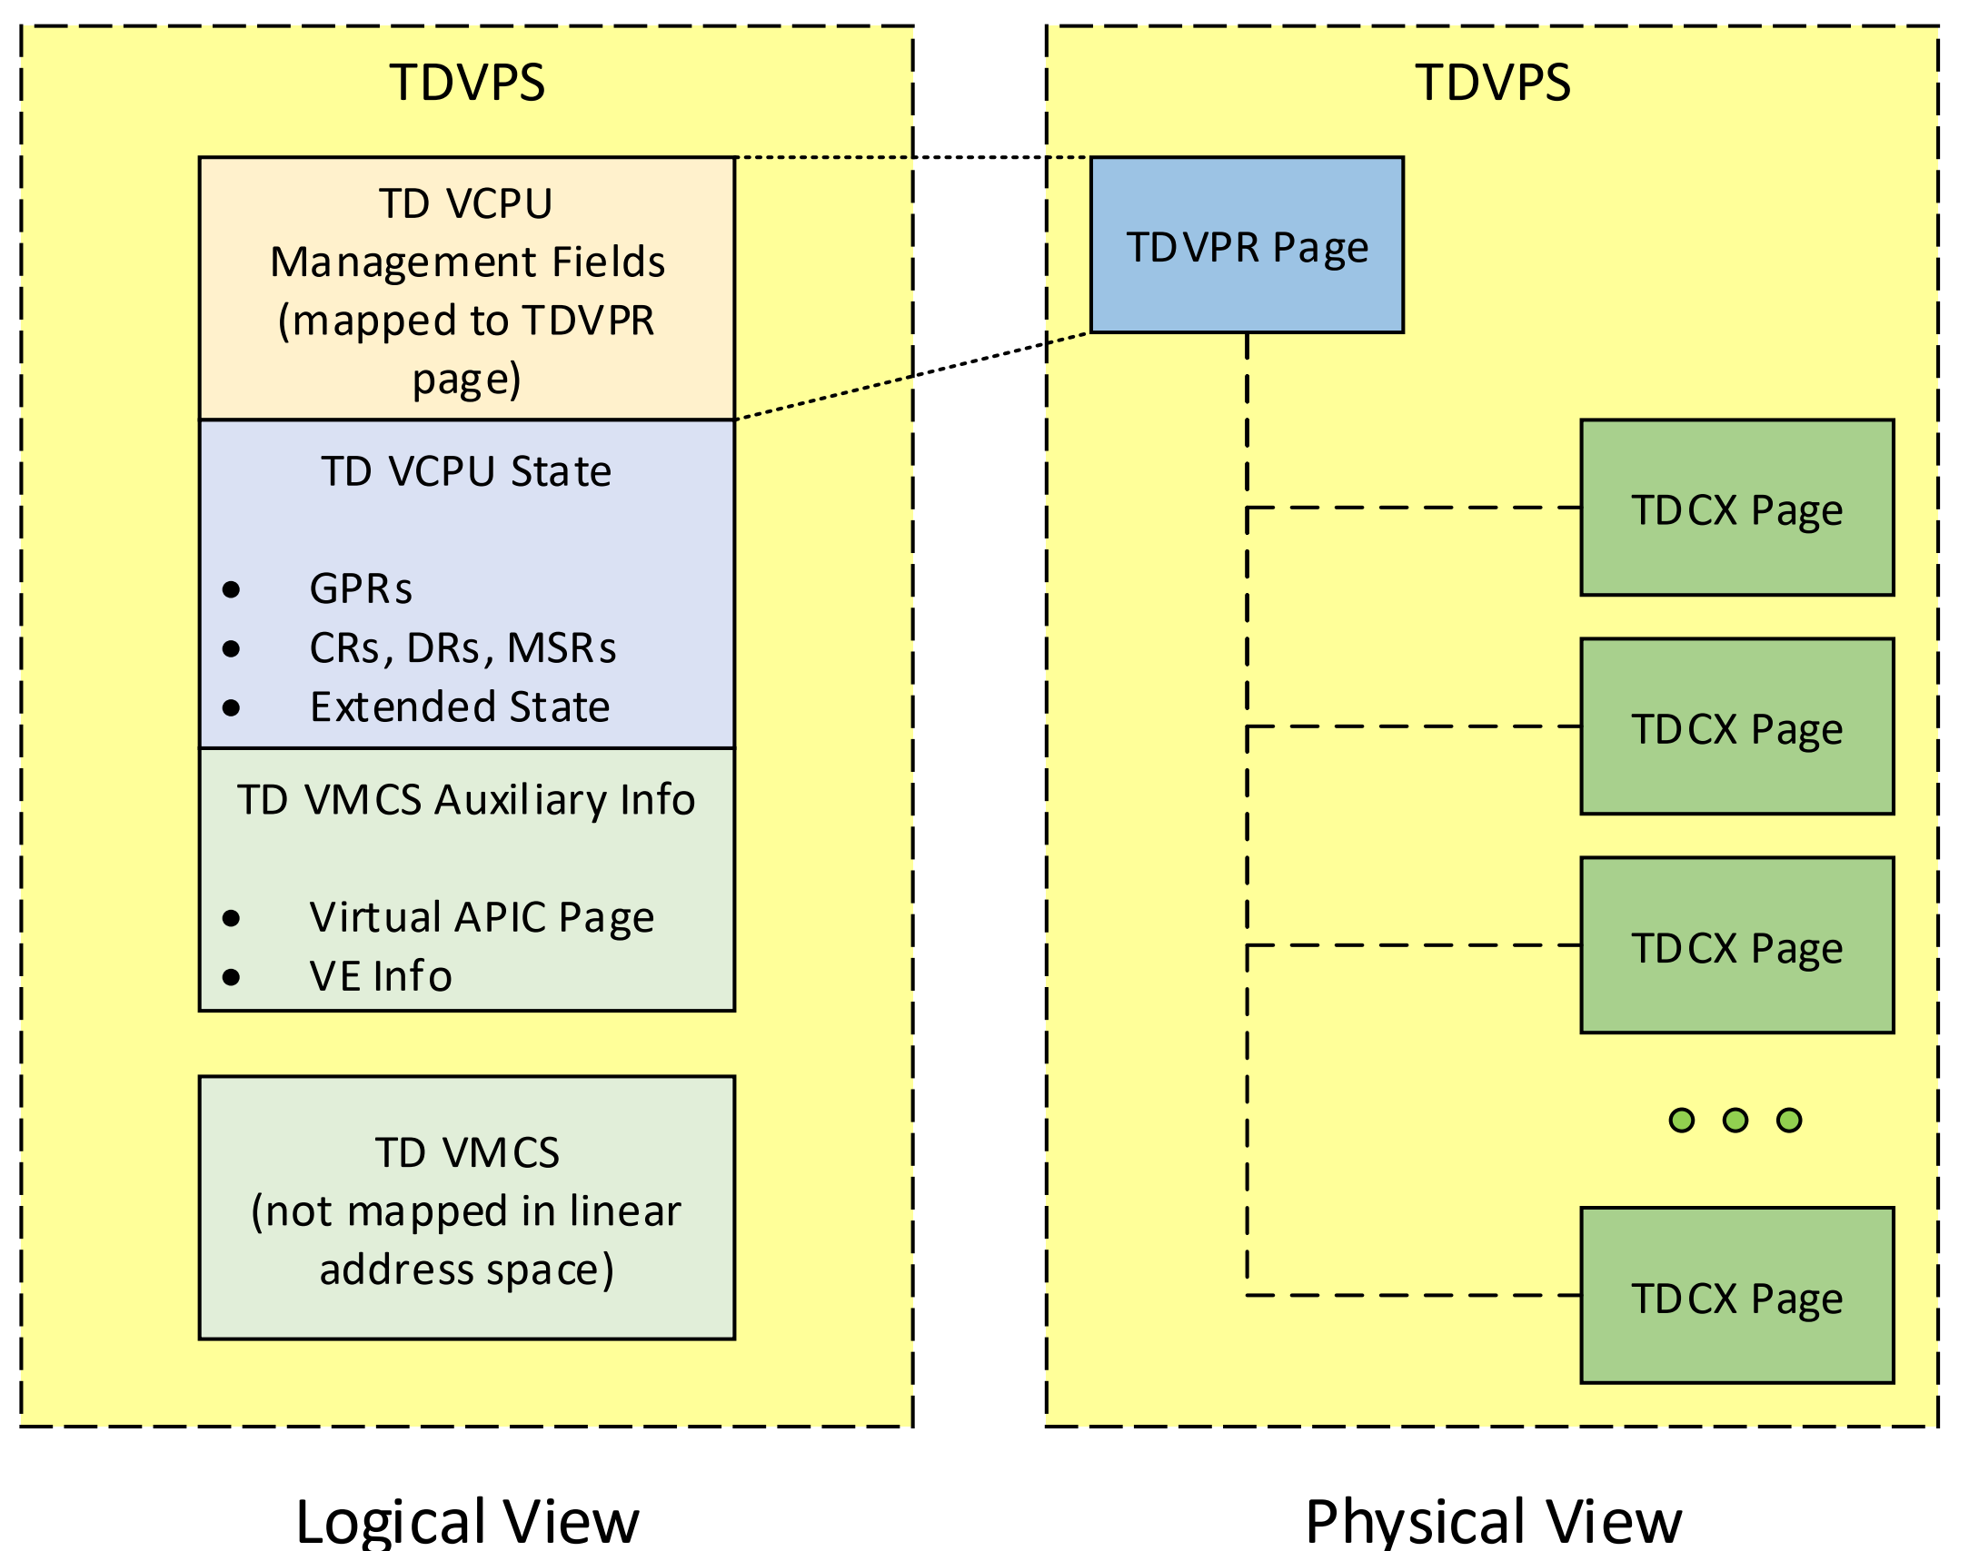
﻿Trust Domain Virtual Processor State (TDVPS)
TDVPS is the root control structure of a TD VCPU.
It helps the TDX module control the operation of the VCPU, and holds the VCPU state while the VCPU is not running.
TDVPS is a single logical control structure composed of multiple physical 4KB pages

Slide 29
Physical view of TDVPS
﻿Trust Domain Virtual Processor Root (TDVPR) is the 4KB root page of TDVPS. Its physical address serves as a unique identifier of the VCPU (as long as it resides in memory).
Trust Domain Control structure eXtension (TDCX) 4KB pages extend TDVPR to help provide enough physical space for the logical TDVPS structure.

Slide 30
Logical view of TDVPS
﻿VMX (with TDX ISA Extensions) Standard Control Structures
TD VMCS
TD VMCS auxiliary structures (virtual APIC page, virtualization exception information)
MSR bitmaps are held as part of TDCS because they are meant to have the same value for all VCPUs of the same TD.
The TDX design doesn’t require some of the VMX control structures (e.g., the Shared EPT) to be protected.
﻿Proprietary Fields
TD VCPU Management fields designed to manage the operation of the VCPU
TD VCPU State fields designed to hold most of the VPCU state (except state that is saved to the TD VMCS) when the VCPU is not running

Slide 31
﻿Non-Protected Control Structures: Shared EPT and VMCS Auxiliary Control Structures
﻿Several VMX control structures are directly managed and accessed by the host VMM
These control structures are pointed to by fields in the TD VMCS
The Intel TDX module checks that the pointers conform to the shared-access HPA semantics
﻿ Non-protected control structures include:
Shared EPT tree
Posted interrupt descriptor

Slide 32
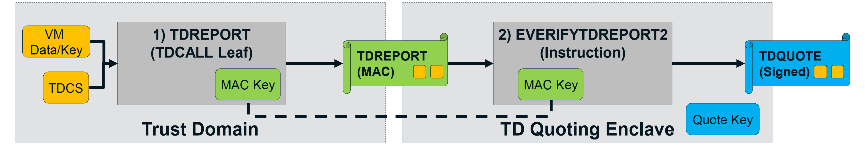
REMOTE ATTESTATION
﻿Guest TD invokes TDCALL(TDG.MR.REPORT) function to request the Intel TDX module to generate an integrity-protected TDREPORT
What items included in TDREPORT?
﻿TD’s measurements, the Intel TDX module’s measurements
value provided by the guest TD software (﻿asymmetric key)
Intel SGX Quoting Enclave, uses a new ENCLU inst,EVERIFYREPORT2, to check the integrity of TDREPORT
﻿﻿To create a remotely verifiable attestation, the TDREPORT_STRUCT should be converted into a Quote signed by a certified Quote signing key
If it passes, the Quoting Enclave can use a certified quote signing key to sign a quote

Slide 33
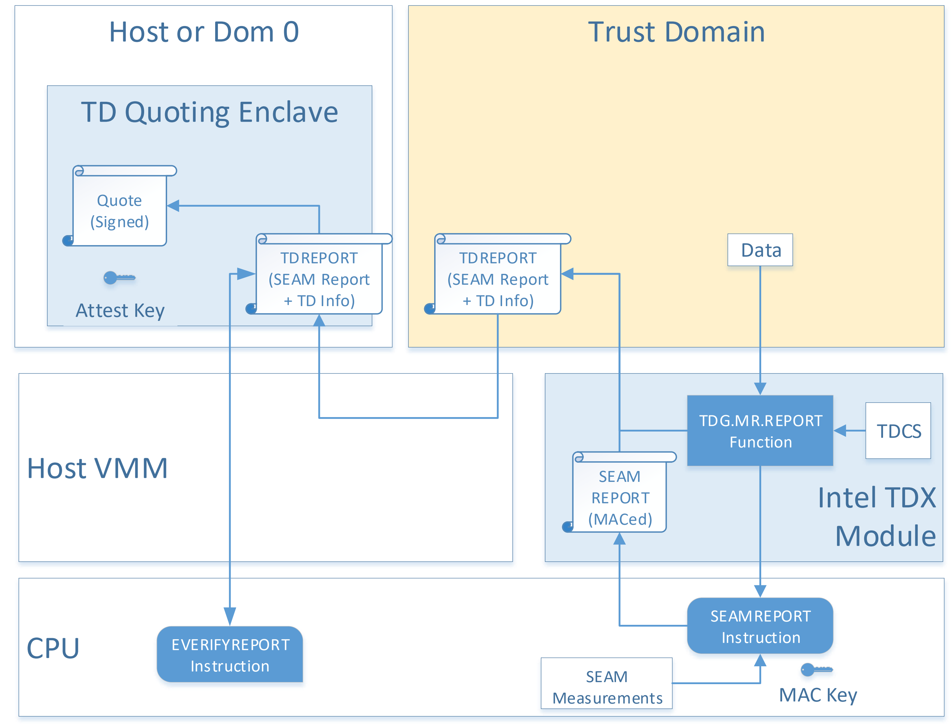
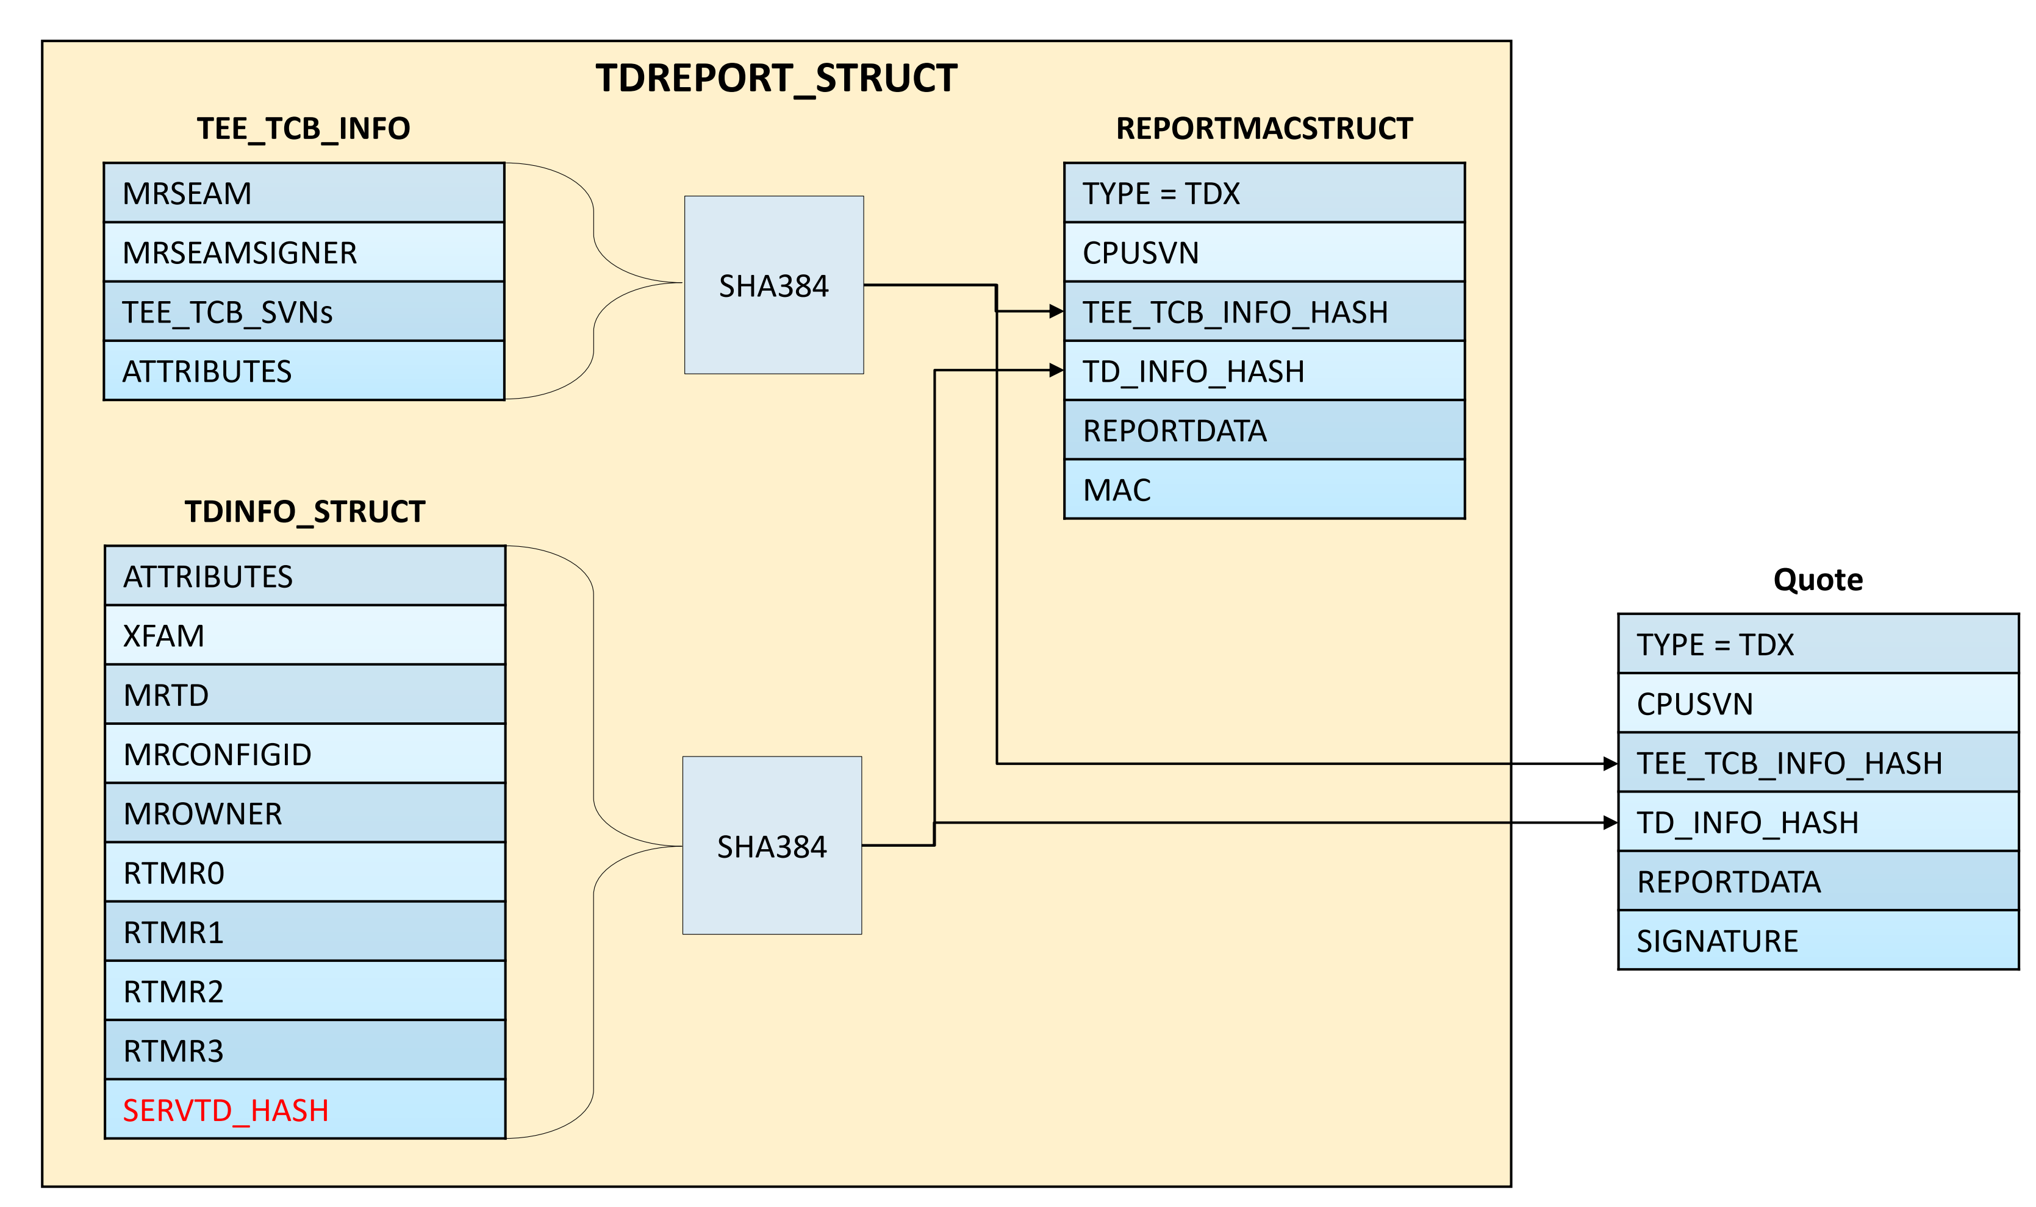
TDREPORT generated by TDG.MR.REPORT

Slide 34
﻿MRTD: Build-Time Measurement Register
﻿The Intel TDX module measures the TD during the build process. The measurement register TDCS.MRTD is a SHA384 digest of the build process, designed as follows:
TDH.MNG.INIT begins the process by initializing the digest.
TDH.MEM.PAGE.ADD adds a TD private page to the TD and inserts its properties (GPA) into the MRTD digest calculation.
Control structure pages (TDR, TDCX and TDVPR) and Secure EPT pages are not measured.
For pages whose data contribute to the TD, that data should be included in the TD measurement via TDH.MR.EXTEND.
TDH.MR.EXTEND inserts the data contained in those pages and its GPA, in 256-byte chunks, into the digest calculation. If a page will be wiped and initialized by TD code, the loader may opt not to measure the initial contents of the page with TDH.MR.EXTEND.
The measurement is then completed by TDH.MR.FINALIZE.
Once completed, further TDH.MEM.PAGE.ADDs or TDEXTENDs will fail.
MRTD extension by GPA uses a 128B buffer which includes the GPA and the leaf function name for uniqueness

Slide 35
﻿RTMR: Run-Time Measurement Registers
The RTMR array is initialized to zero on build, and it can be extended at run-time by the guest TD using the TDCALL(TDG.MR.RTMR.EXTEND) leaf.
The syntax of the RTMR registers is designed to be similar to that of TPM PCRs, where a register’s value after TDG.MR.RTMR.EXTEND(index=i, value=x) is:
RTMR[i] = SHA384(RTMR[i] || x);
Four RTMR registers are provided.
Typical expected usage is for TPM emulation during guest TD OS secure boot by the VBIOS

Slide 36
REMOTE ATTESTATION
The Intel TDX ISA provides support for enabling the Intel TDX module to create TDREPORT structure
TDMR: TD-measurement register, a static measurement register
TDX module Extends TDMR with the measurements of the initial pages added to the TD along with metadata associated with pages
RTMR: runtime-extendable-measurement registers
It would be extended by the code in the TD with measurements of additional code and data at runtime.
Use an Elliptic-Curve-Digital-Signature-Algorithm (ECDSA)-based, asymmetric-attestation key representing the Intel-TDX-TCB version in order to sign an assertion (a Quote) with the information listed above

Slide 37
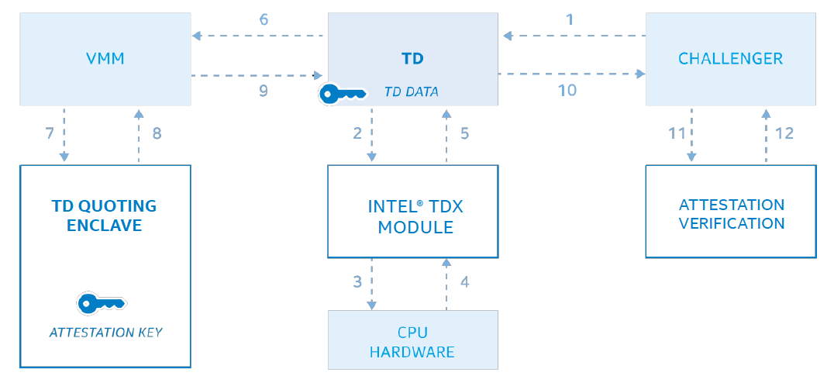
Intel SGX + TDX
The Intel-TDX utilizes an Intel-SGX enclave, called the TD-quoting enclave, to generate the remote attestation for a TD (6-9)
a new instruction, SEAMREPORT, to be invoked only by Intel-TDX module and create an evidence structure that is cryptographically bound to the platform hardware (3,4)

Slide 38
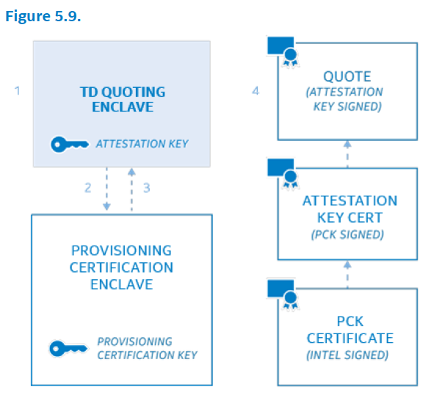
Intel SGX + TDX
Intel® Software Guard Extensions Data Center Attestation Primitives (Intel® SGX DCAP), to help certify TD-quoting Enclaves with a certificate chain rooted to an Intel-issued certificate.
Intel-provided enclave called the Provisioning-Certification Enclave (PCE), which is designed to act as a local, Certificate Authority for local TD-quoting Enclaves

Slide 39
﻿TD attestation is initiated from inside the TD by calling TDG.MR.REPORT and specifying a REPORTDATA value.
TDG.MR.REPORT creates a TDREPORT_STRUCT structure containing the TD measurements, initial configuration of the TD
that was locked at finalization (TDH.MR.FINALIZE), the Intel TDX module measurements, and the REPORTDATA value.
TDREPORT_STRUCT structure and TDG.MR.REPORT are detailed in the [TDX Module ABI]

Slide 40
Life cycle of TD
﻿The host VMM can create a new guest TD by allocating and initializing a TD Root (TDR) control structure (KEY MANAGEMENT)
﻿host VMM assigns the TD with a memory protection key identifier, also known as a Host Key ID (HKID). ﻿The HKID can be used by the multi-key total memory encryption engines (MKTMEs) to select the encryption/decryption keys
﻿Once the TD is assigned a key, the host VMM can build the TD Control Structure (TDCS) by adding control structure pages
﻿It can build the Secure EPT tree and initial set of TD-private pages (For Virtual BIOS)
﻿These pages typically contain Virtual BIOS code and data along with some clear pages for stacks and heap. Most of the guest TD code and data is dynamically loaded at a later stage.
﻿The host VMM can then create and initialize TD Virtual CPUs (VCPUs). After creating, the VMM allocates a set of pages to hold the VCPU state (in a structure called TDVPS)
﻿After the initial set of pages is added and extended, the VMM can finalize the TD measurement

Slide 41
Continued..
﻿﻿The host VMM may enter the TD (launch the TD for the first time, or resume a previously intercepted TD execution)
The Intel TDX module is designed to load CPU state from the TDVPS structure and perform VM entry to go into TDX non-root mode.
﻿During TD lifetime, the VMM might need to dynamically control the TD and manage the resources assigned to it.
Adding and removing TD pages.
Changing page mapping sizes.
Reclaiming the HKIDs from a TD, and assigning them to another TD.
Destroying an existing TD.

Slide 42
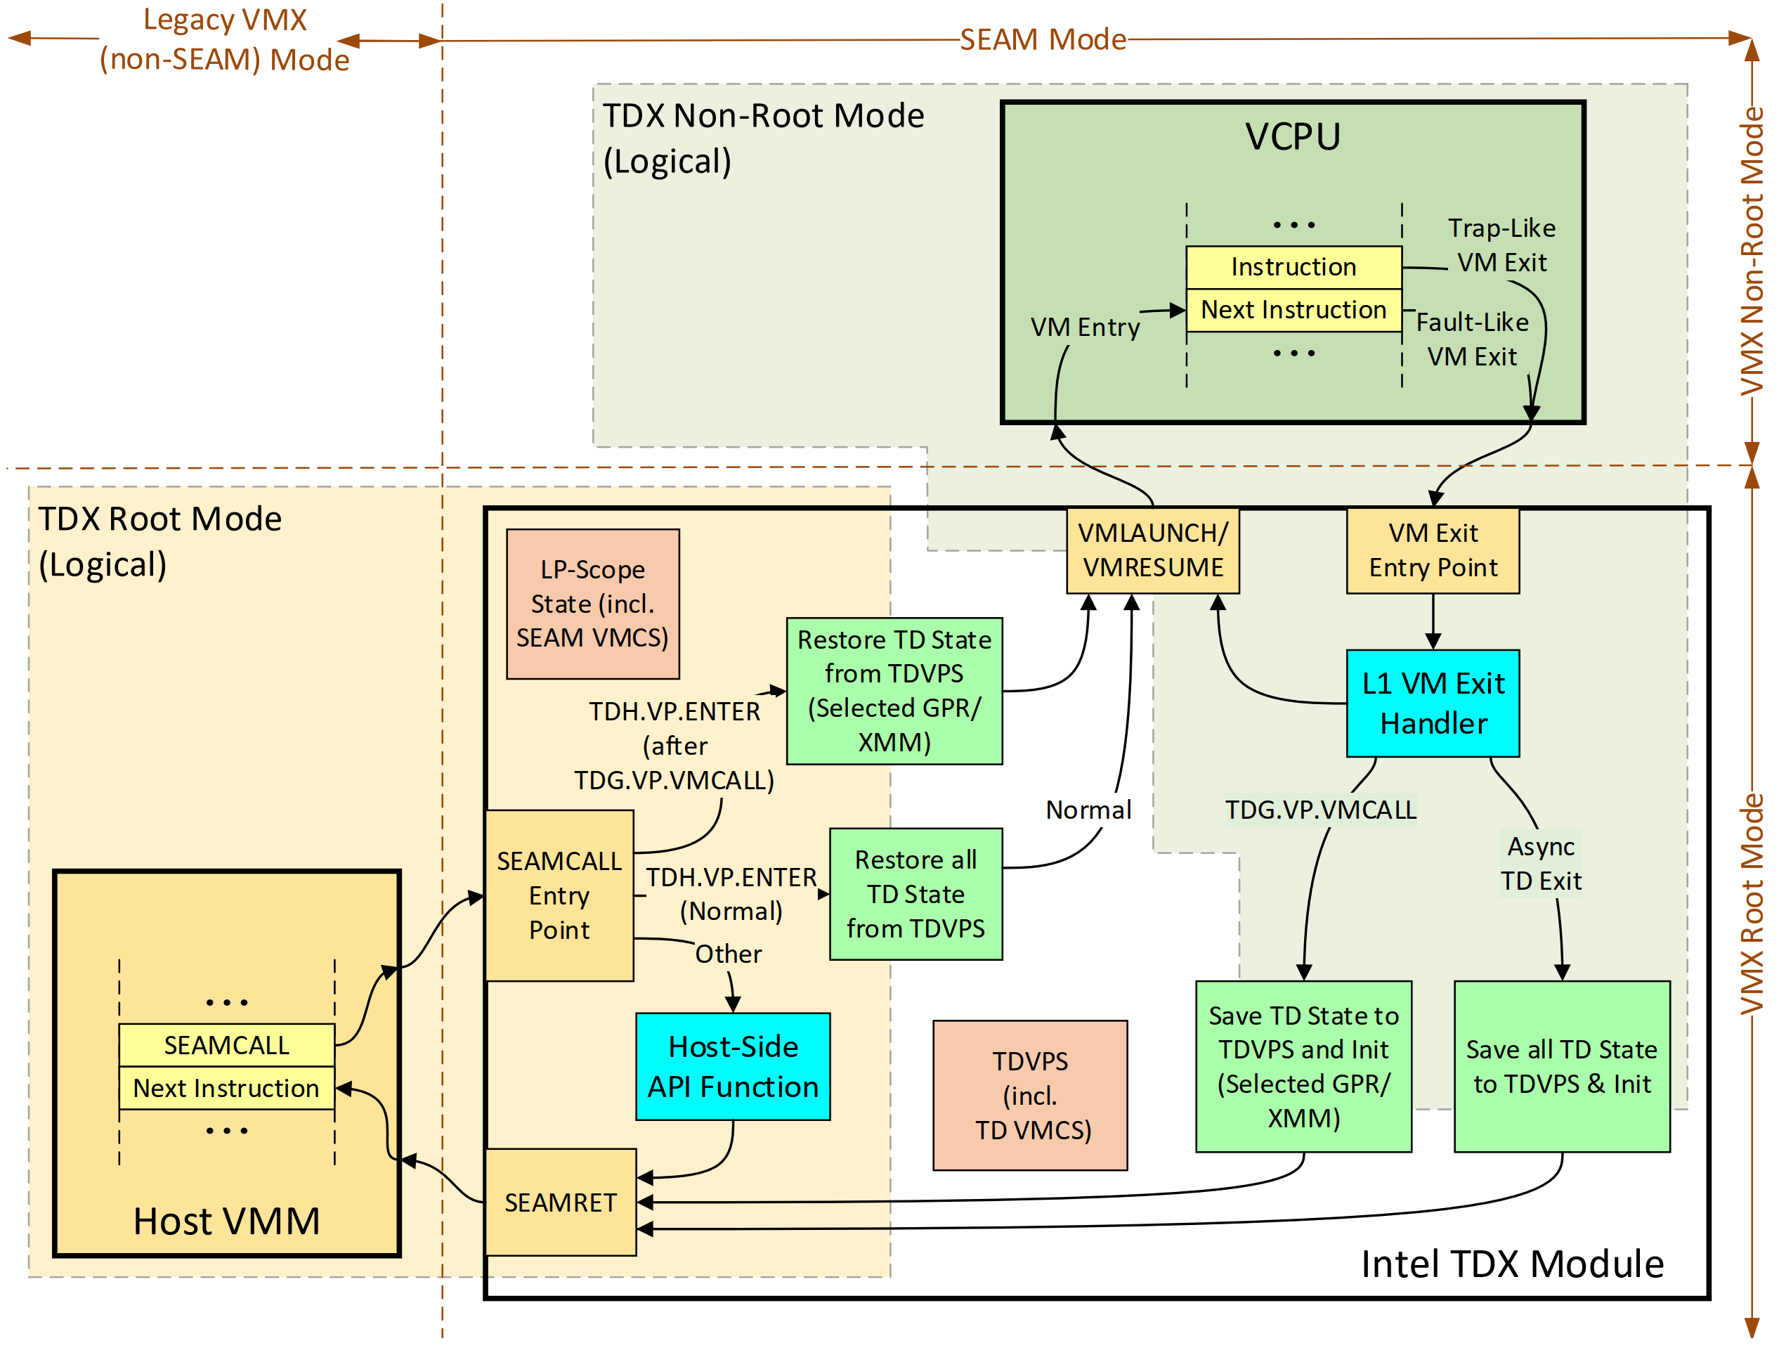
TD VCPU transitions

Slide 43
TD exit and CPU status
﻿On asynchronous TD exits
happen due to exceptions or external events
the CPU state is saved to the VCPU control structures
a synthetic state is loaded into the CPU registers.
On the following TD Entry, the CPU state is restored from the protected control structures.
On synchronous TD-initiated exit
using the TDCALL(TDG.VP.VMCALL) function,
selected GPR and XMM state can be passed as-is to the host VMM.
On the following TD entry, that state can be passed back as-is to the guest TD

Slide 44
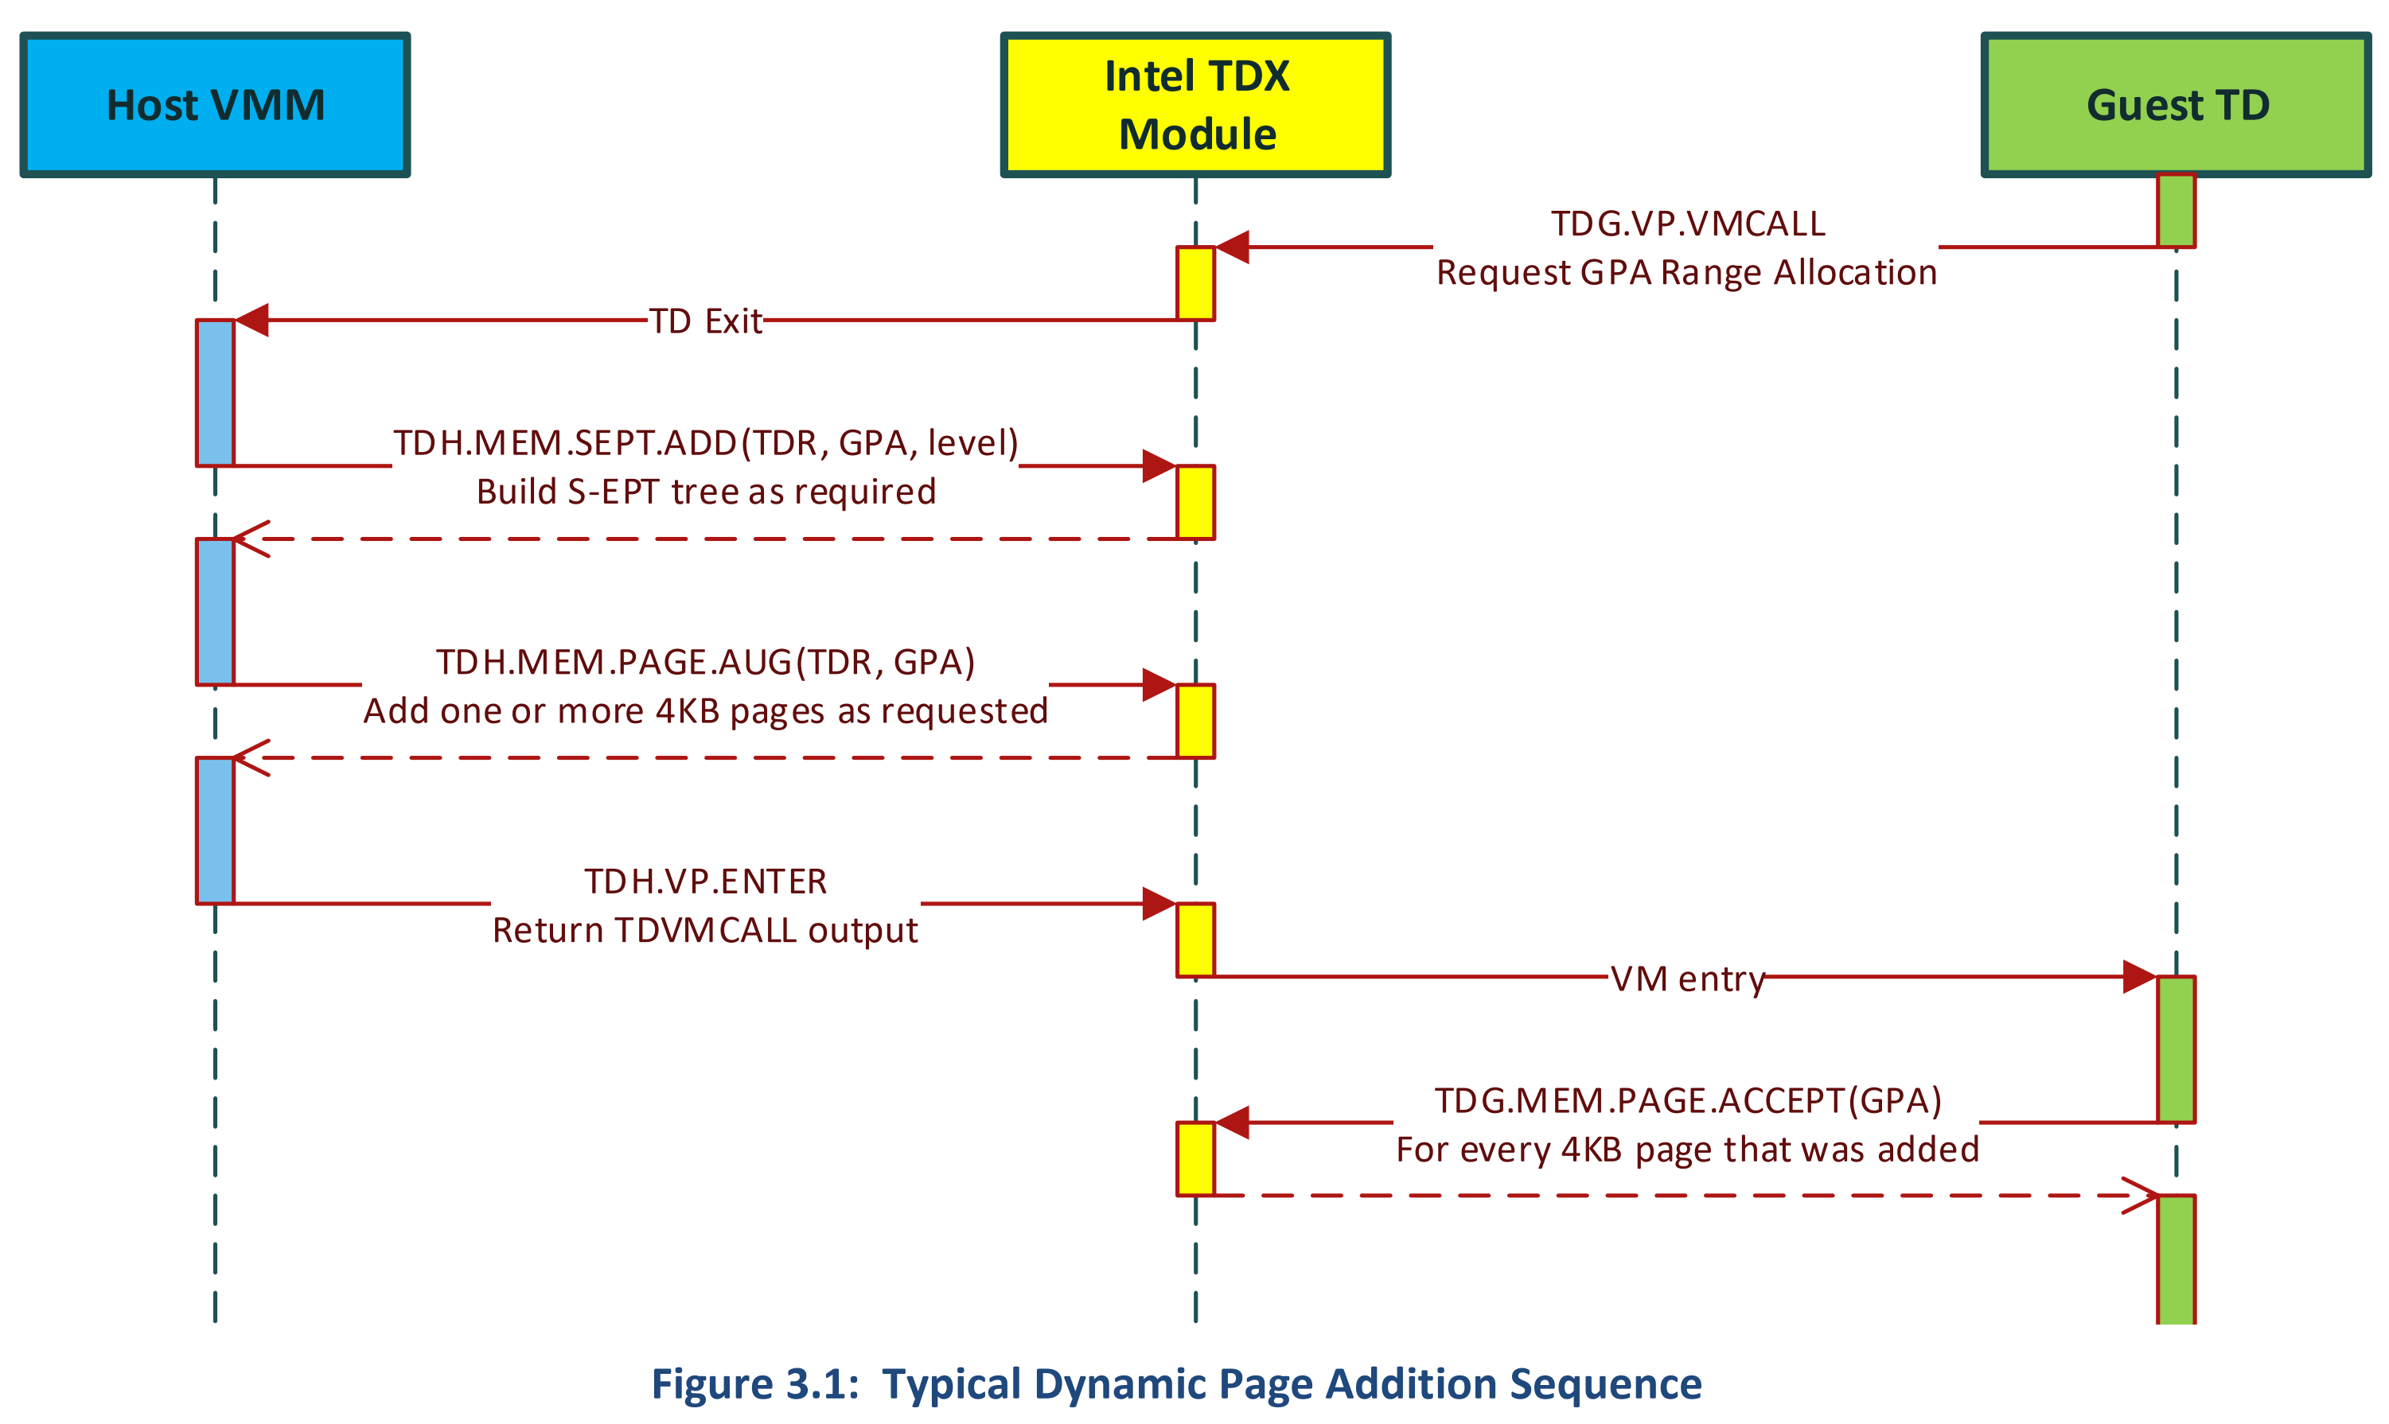
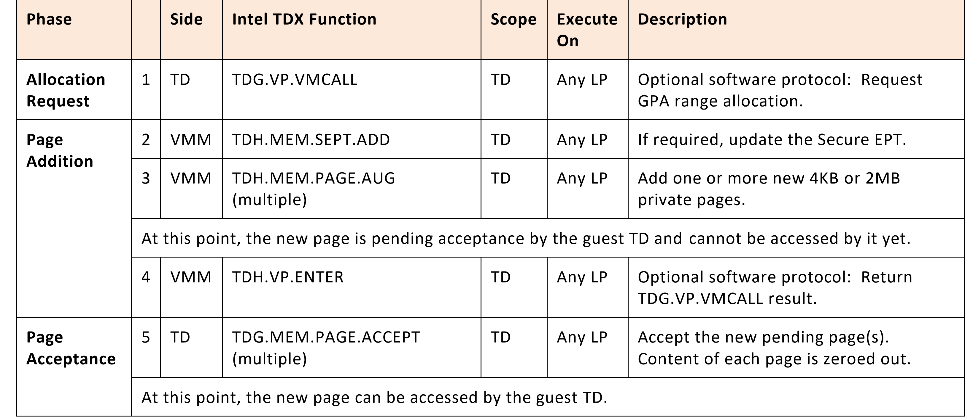
TD in actions
﻿Dynamic Page Addition after initialization of TD (Shared to Private Conversion)

Slide 45
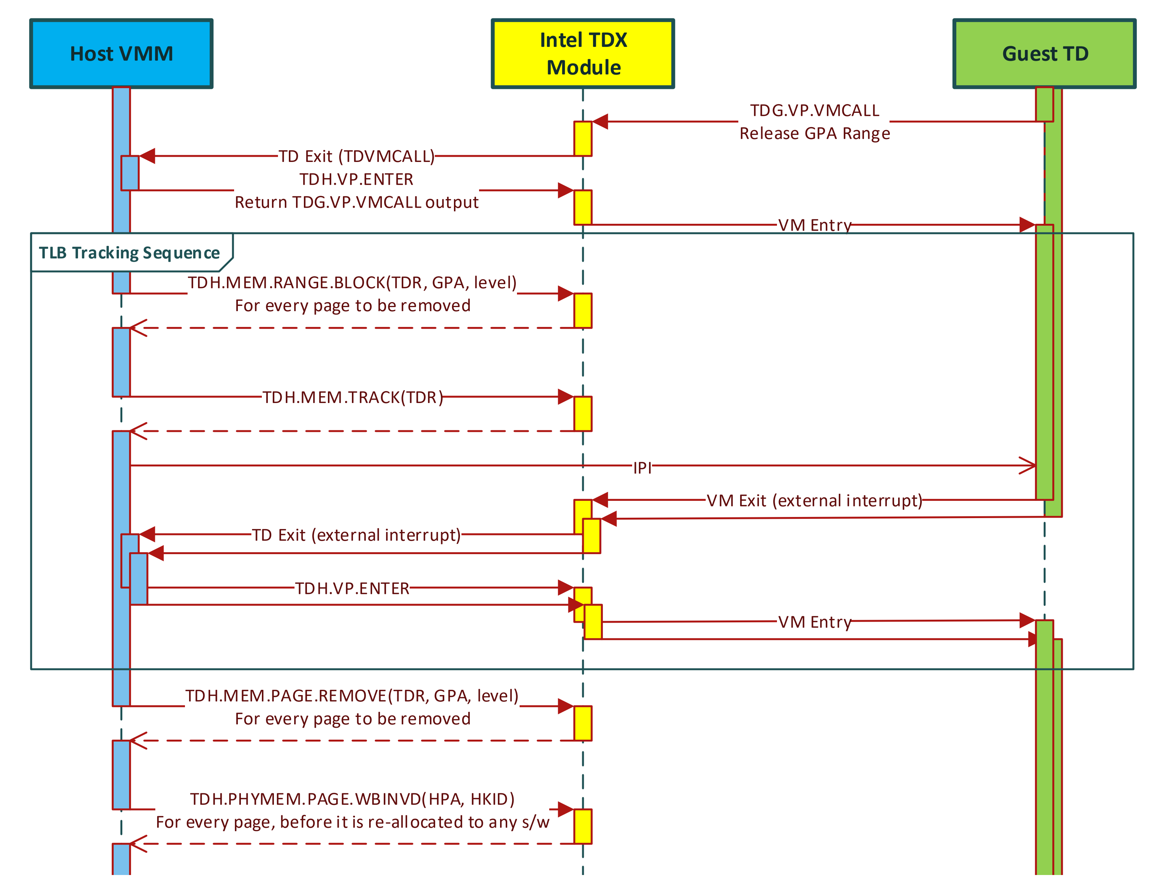
TD in actions
﻿Dynamic Page Removal (Private to Shared Conversion)
It requires TLB tracking Sequence
﻿Used by the host VMM to help guarantee no EPT TLB entries exist to a set of GPA ranges

Slide 46
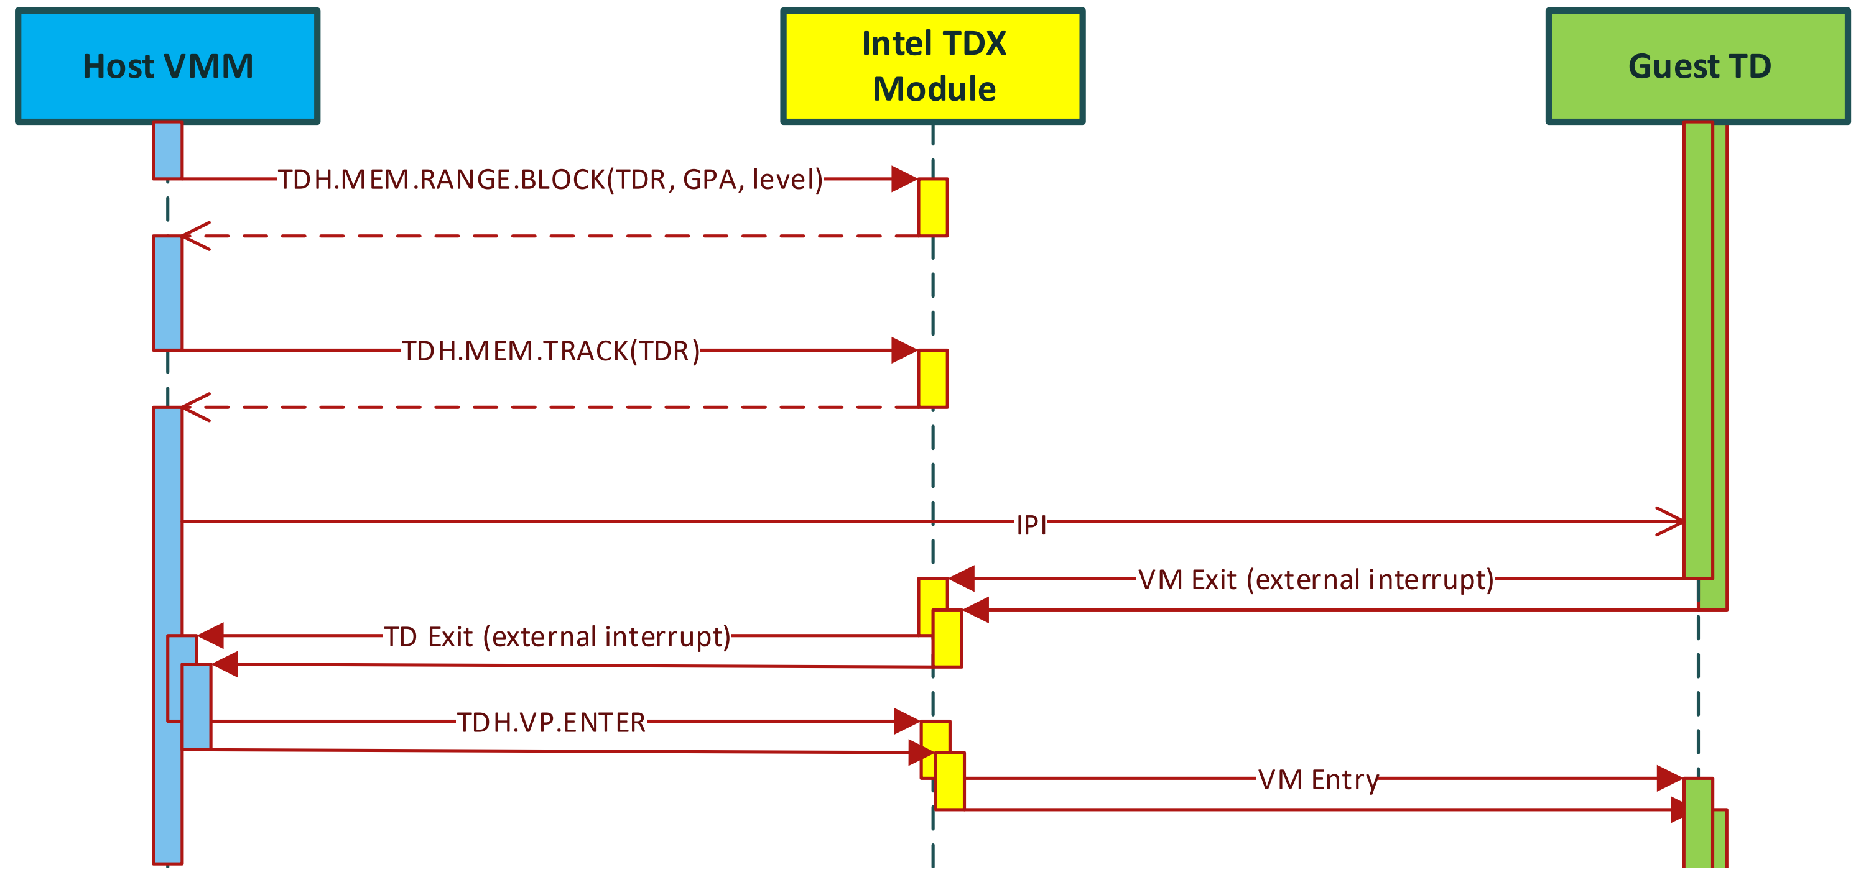
﻿GPA Range TLB Tracking Sequence
1. Execute TDH.MEM.RANGE.BLOCK on each GPA range, blocking subsequent creation of TLB translation to that range. Note that cached translations may still exist at this stage.
2. Execute TDH.MEM.TRACK, advancing the TD’s epoch counter.
3. Send an Inter-Processor Interrupt (IPI) to each Remote Logical Processor (RLP) on which any of the TD’s VCPUs is currently scheduled.
4. Upon receiving the IPI, each RLP will TD exit to the host VMM (At this point the target GPA ranges are considered tracked. Even though some LPs may still hold TLB entries to the target GPA ranges, the following TD entry is designed to flush them)
5. Normally, the host VMM on each RLP will treat the TD exit as spurious and will immediately re-enter the TD.

Slide 47
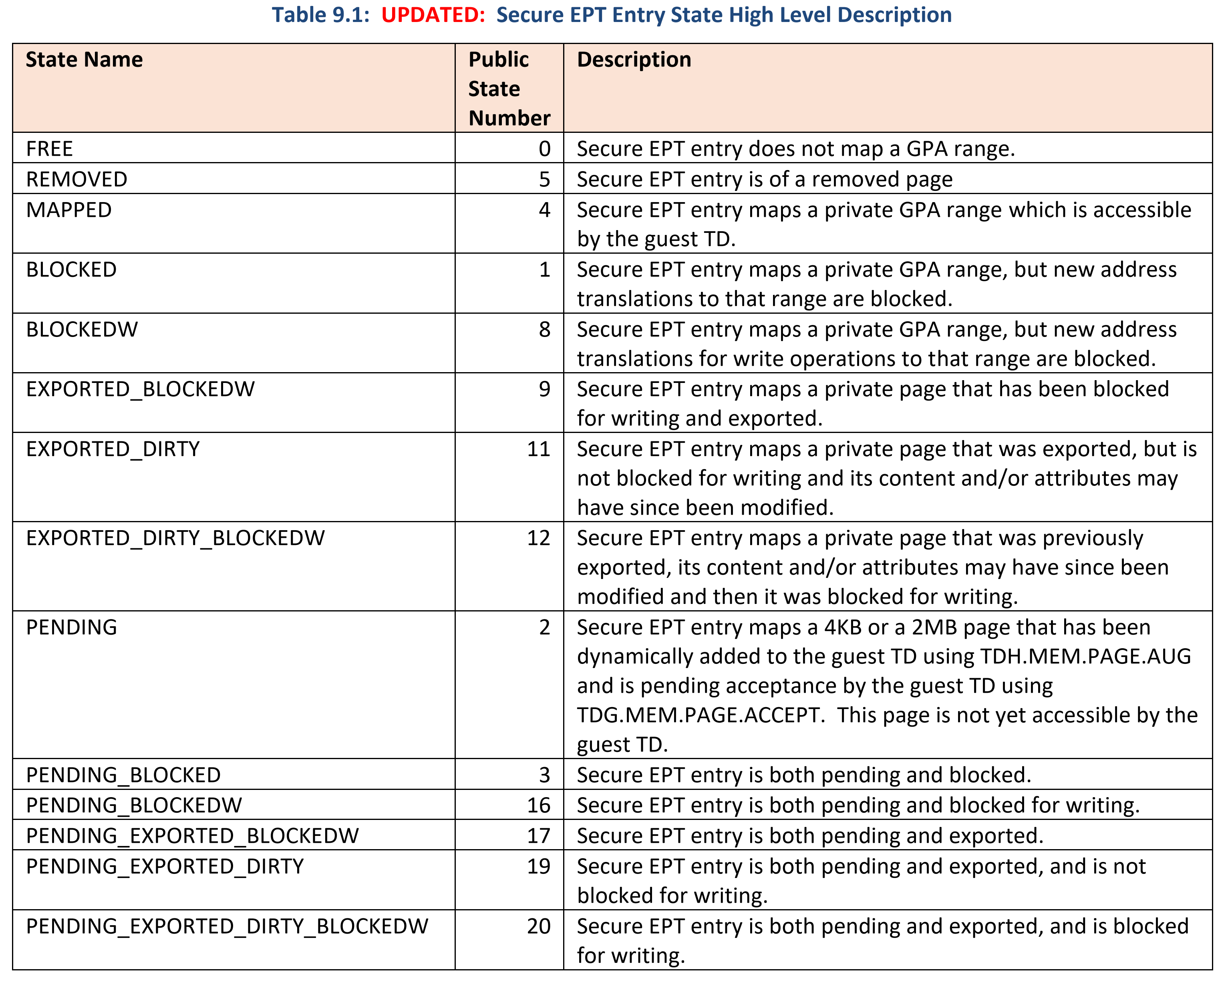
﻿Secure EPT Entry
﻿From the CPU perspective, Secure EPT has the same structure as a legacy VMX EPT.
For private memory management, the Intel TDX module hold a state value in each Secure EPT entry (encoded by multiple bits)
﻿Secure EPT entry is opaque; the host VMM may not access it directly. The host VMM may read a Secure EPT entry information using the TDH.MEM.SEPT.RD interface function
When should it be allowed or not?

Slide 48
﻿Secure EPT Walk
﻿Host-side (SEAMCALL) TDX functions that manage TD private memory usually accept GPA and Level parameters.
They perform a Secure EPT walk which locates the target Secure EPT entry.
If the Secure EPT walk is completed successfully, the Intel TDX function may operate on the located Secure EPT entry.
Otherwise, the function typically returns the last visited EPT entry and its level to the host VMM
Why Host needs EPT walking..?
﻿Guest-side (TDCALL) Intel TDX functions typically perform an EPT walk similar to the EPT walk done by the CPU.
Only the GPA is provided as an input, and the function may walk the Shared EPT or the Secure EPT, depending on the specific function and the GPA’s SHARED bit

Slide 49
﻿ Secure EPT Induced TD Exits
﻿Guest TD memory access to a non-present private GPA causes an asynchronous TD exit with an EPT Violation exit reason.
a non-present GPA is any private GPA for which there is either no Secure EPT entry, or the Secure EPT entry is not in the MAPPED state.
There is no TD exit with an EPT Misconfiguration on the Secure EPT.
On EPT violation TD exit, the content of the Secure EPT entry is provided to the host VMM to avoid the need for explicitly reading it using TDH.MEM.SEPT.RD.
Secure EPT-induced TD exits may also be triggered during a guest-side local flow, performing some function on behalf of the guest TD, and executed by the Intel TDX module.

Slide 50
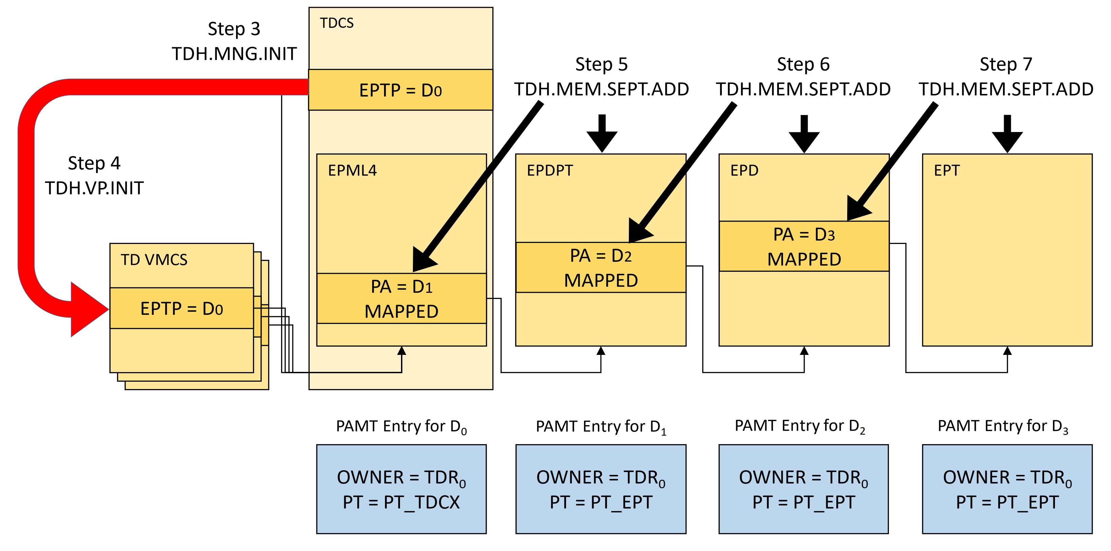
How to build secure EPTP
﻿1. The host VMM calls TDH.MNG.CREATE(TDR_PA = TDR0) to create the TD.
2. The host VMM calls TDH.MNG.ADDCX(TDR_PA = TDR0, DST_PA = TDCX_PAGE_PA) multiple times to allocate pages for TDCS. One of those pages will be used to host the Secure EPT root page D0.
3. Host VMM calls TDH.MNG.INIT(TDR_PA = TDR0) to initialize the TD and set an EPML4 page in one of the previously added TDCX pages as the Secure EPT root page. This updates TDCS.EPTP.
4. TDH.VP.INIT of each VPCU copies TDCS.EPTP to the TD VMCS’s EPTP field.
5. Host VMM calls TDH.MEM.SEPT.ADD(TDR_PA = TDR0, DST_PA = D1, GPA = G0, LVL= 3) to add an EPDPT page.
6. Host VMM calls TDH.MEM.SEPT.ADD(TDR_PA = TDR0, DST_PA = D2, GPA = G0, LVL= 2) to add an EPD page.
7. Host VMM calls TDH.MEM.SEPT.ADD(TDR_PA = TDR0, DST_PA = D3, GPA = G0, LVL= 1) to add an EPT page.

Slide 51
﻿Intel TDX I/O Model
﻿The TD guest can use the following I/O models:
Paravirtualized devices
Paravirtualized devices with MMIO emulation
Direct assignment of devices to a TD
﻿The Intel TDX architecture does not provide specific mechanisms for trusted I/O.
Any integrity or confidentiality protection of data submitted to or received from physical or emulated devices must be done by the guest software

Slide 52
﻿Paravirtualized I/O
﻿ The guest TD drivers can use the TDG.VP.VMCALL function to invoke the functions provided by the VMM to perform I/O.
The TD drivers must ensure that the data buffers passed to/from functions invoked using TDG.VP.VMCALL are placed in the TD’s shared memory space

Slide 53
﻿MMIO Emulation and Emulated Devices
﻿use non-para-virtualized drivers in the guest TD, with the emulation performed by the #VE handler.
﻿EPT and #VE mechanisms can be used to reflect violations to the #VE handler in the guest TD on access to virtual MMIO ranges (Set EPT to generate #VE when the MMIO region is read/written by TD)
﻿These violations invoke #VE handler in TD and it invokes VMM-provided MMIO emulation functions through TDG.VP.VMCALL.
In this model, the #VE handler is expected to emulate the faulting instruction in the guest TD

Slide 54
Side channel mitigations
﻿For single step attacks, the TDX module detects when a TD VCPU gets interrupted soon (~4K cycles) after it was entered, and continues to provide execution opportunities to the TD VCPU for a small random number of instructions before the interruption is delivered to the host VMM
﻿ the Intel TDX module counts Secure EPT faults. After a pre-determined number of such EPT violations occur on the same instruction, the TDX module starts tracking the GPAs that caused Secure EPT faults and fails further host VMM attempts to enter the TD VCPU unless previously faulting private GPAs are properly mapped in the Secure EPT

Slide 55
Side channel mitigations
﻿The TDX module provides the guest TD with a notification facility, by which the guest TD can get notified when excessive Secure EPT violations are raised by the same TD instruction.
﻿This mechanism allows the guest TD to employ its own policies
﻿The guest TD enables this notification by setting bit 0 of TDCS.NOTIFY_ENABLES field, using TDG.VM.WR
﻿When this bit is set, the Intel TDX module raises #VE exception when more than a pre-determined number of Secure EPT violations are detected on the same instruction, with #VE information containing EPT violation details.

Slide 56
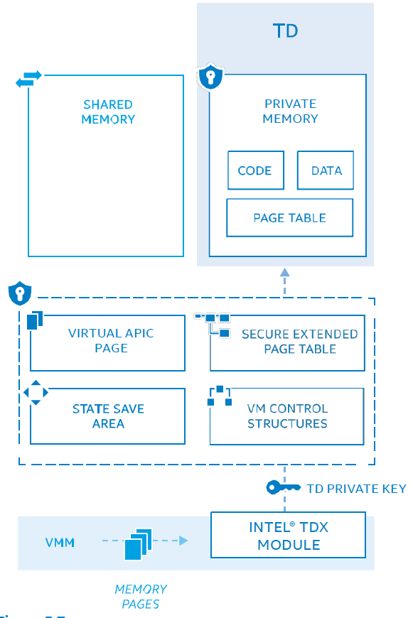
SECURE INTERRUPT AND EXCEPTION DELIVERY
Interrupts and exception delivery to the TD using VMX-APIC virtualization and virtual-interrupts
The APIC-virtualization provides CPU emulation of many registers of the APIC and deliver virtual interrupts.
The CPU would do all the above in VMX-non-root operation without requiring a VM exit from the TD
CPU tracks the state of the virtual APIC using a virtual-APIC page and related state in the VMCS
The VMX-posted-interrupts-processing architecture allow a VMM or devices to deliver virtual interrupts directly to a TD through a posted-interrupt descriptor processed by the CPU hardware in response to a notification interrupt.
The virtual interrupts in the posted interrupt descriptor would then be delivered to the TD through the virtual APIC by the CPU.
The VMX architecture is designed to disallow injection of exceptions into a TD
Q: How the TDX prevents VMM from falsely injecting the interrupt, but delivering the hardware generated interrupts to the TD?

Slide 57
Caching Translations Information
Address translation caching architecture is augmented with an additional in-SEAM state to support SEAM.
The combined mappings are associated with: Current VPID, Current PCID (non-global translations) or any PCID (global translations), Current EP4TA (when 4-level EPT is active) or current EP5TA (when 5-level EPT is active), Current In-SEAM.
Newly created, guest-physical mappings are associated with current EP4TA or current EP5TA from the EPTP field of the VMCS
Does it mean that shared EPT mappings will not be cached?

Slide 58
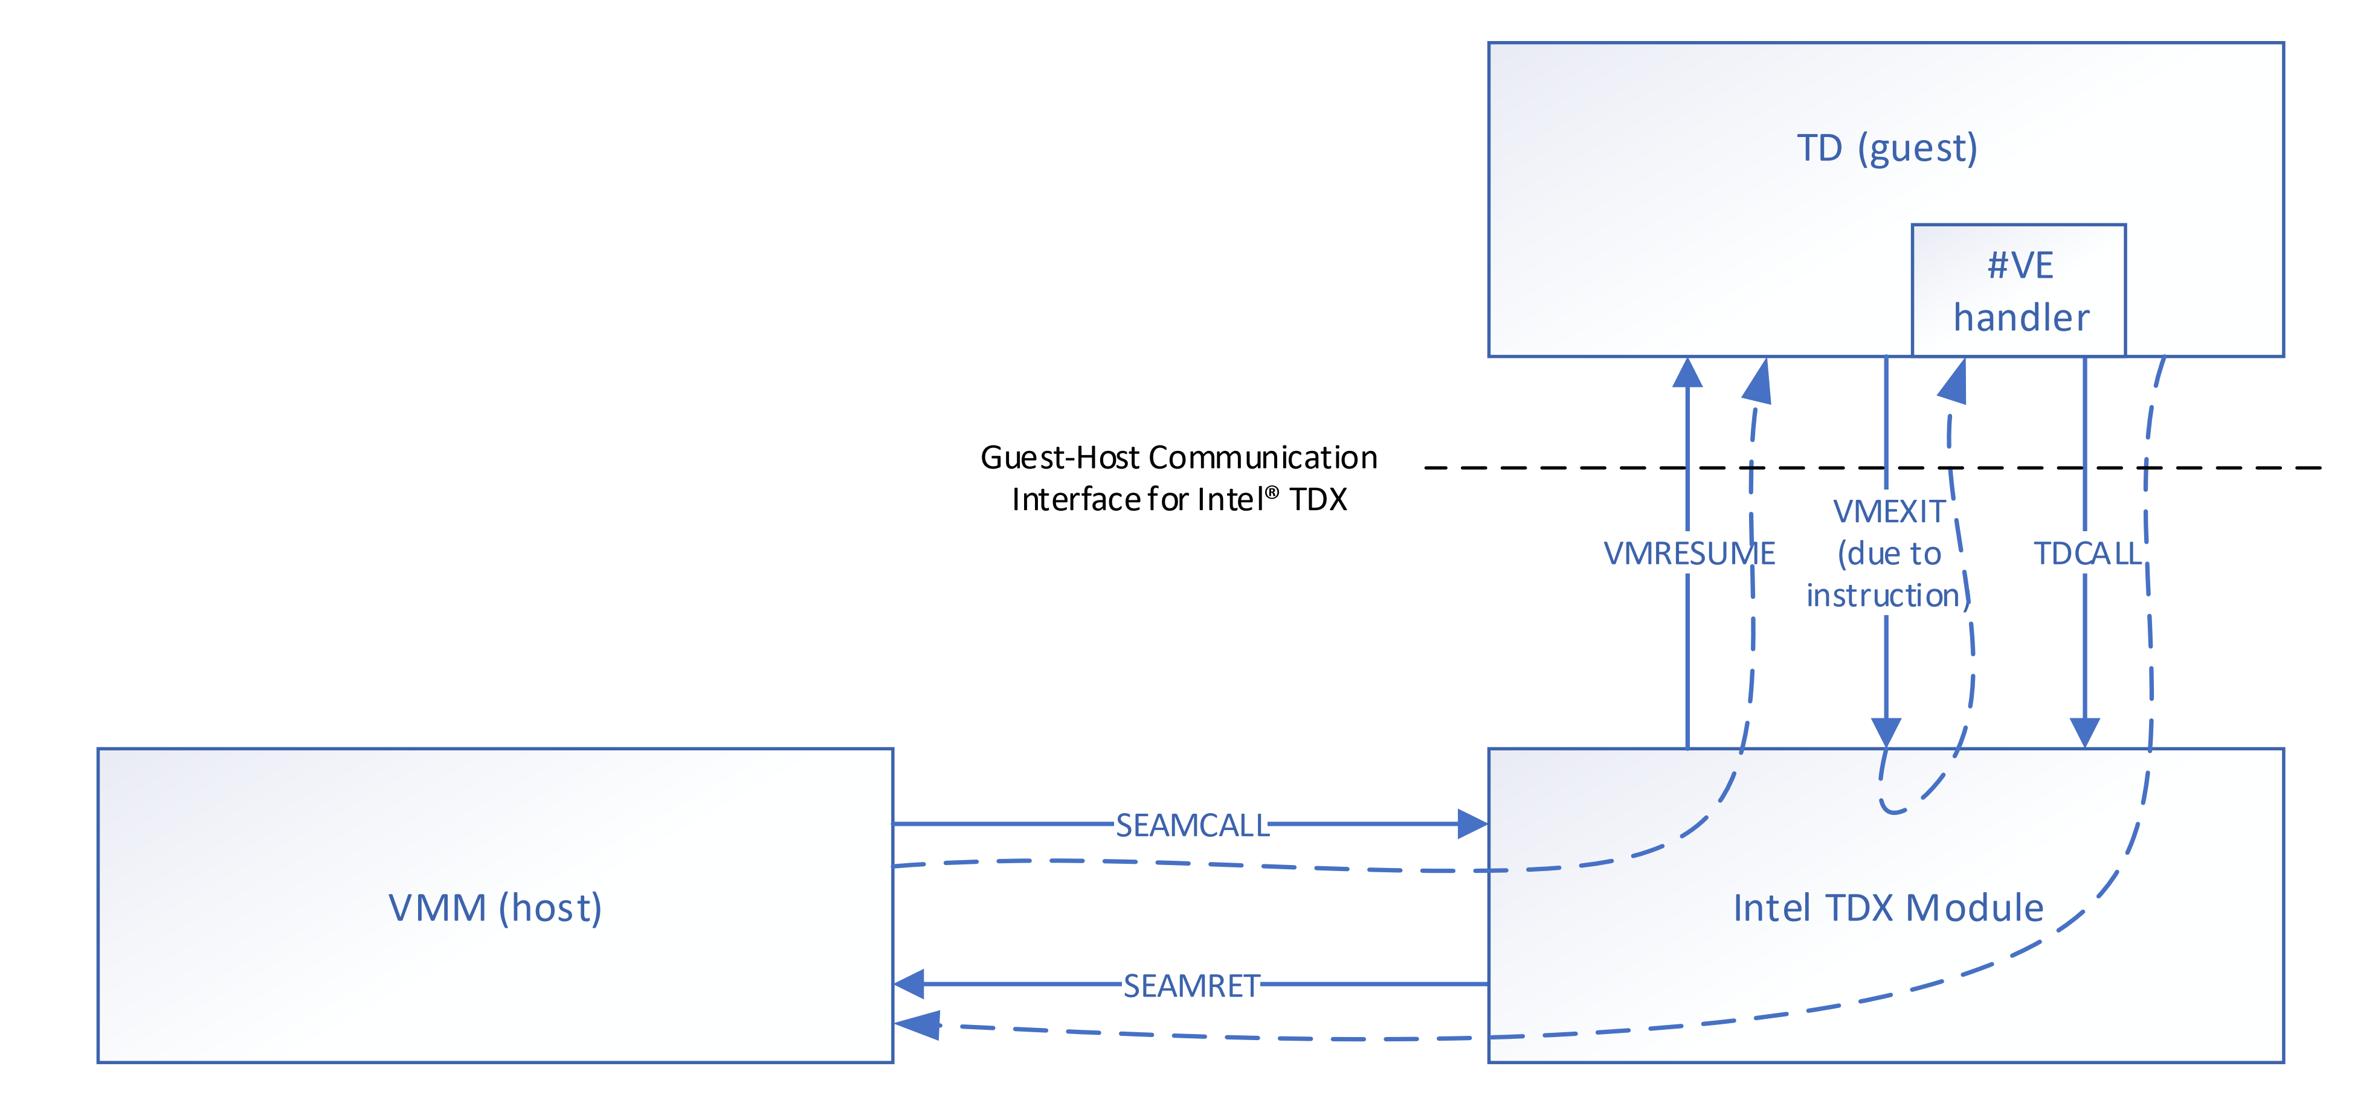
TD<->TDX<->VMM
﻿﻿TD-VMM communication can occur via asynchronous, VM exits or via synchronous (instruction), VM exits
﻿In response to the synchronous (instruction), VM exits, Intel TDX is designed to generate a Virtualization Exception (#VE) for instructions the TD would be disallowed to invoke.
﻿The TD-guest software may respond by using the Intel TDX-provided information directly and/or after further decoding of the instruction that caused the #VE (provided by TDX HW). TD response must be via a TDCALL instruction requesting the host VMM to provide (untrusted) services.
﻿The goal is for the VMM to receive the service request via a SEAMRET invoked by the Intel TDX module, complete the service requested, and respond to the TD via the SEAMCALL[TDH.VP.ENTER] to re-enter the TD
From the perspective of the host VMM, TDCALL [TDG.VP.VMCALL] is a trap-like, VM exit into the host VMM reported via the SEAMRET instruction
By design, after the SEAMRET, the host VMM services the request specified in the parameters passed by the TD during the TDG.VP.VMCALL (that are passed via SEAMRET to the VMM)

Slide 59
﻿Virtualization Exception (#VE)
﻿Virtualization exceptions occur only with certain settings of certain VM-execution controls. certain conditions that would normally cause VM exits instead cause virtualization exceptions (VMEXIT->#VE)
﻿Intel TDX can cause #VE to be reported to the guest-TD software (guest kernel) in cases of disallowed, instruction execution, i.e., IO accesses, etc (TD VCPU prevents some operations of TDs).
#VE in TDX are used to para-virtualize special instruction (e.g., for legacy drivers and I/O)

Slide 60
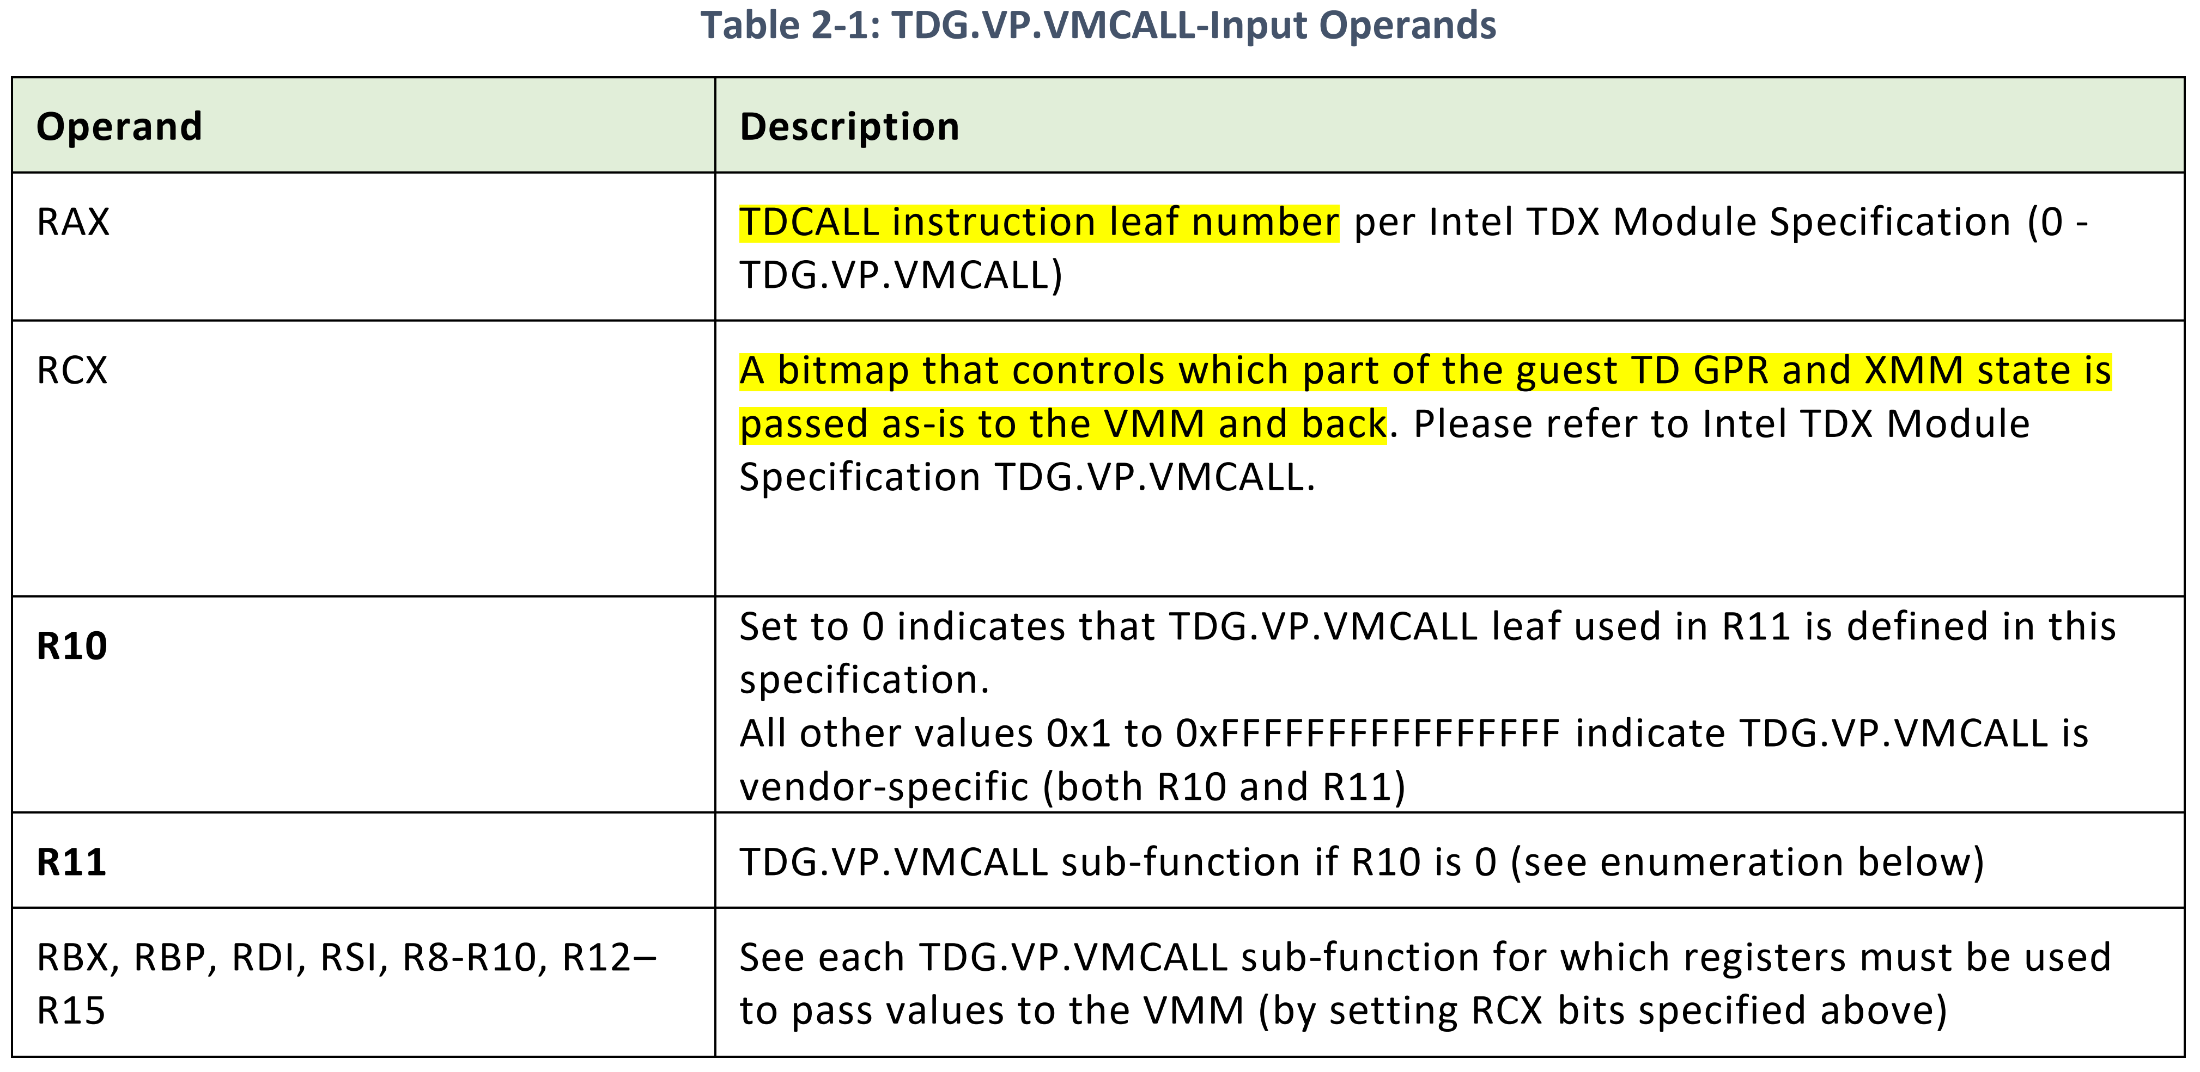
TDCALL(﻿TDG.VP.VMCALL) — Call to VM Monitor from TD Guest
This instruction is designed to allow guest privileged software to make a call for service into a VM monitor
﻿The goal is asking services from the host VMM at the end
The programming interface for such calls are Intel TDX module-specific; this instruction can cause a VM exit, registering the appropriate exit reason

Slide 61
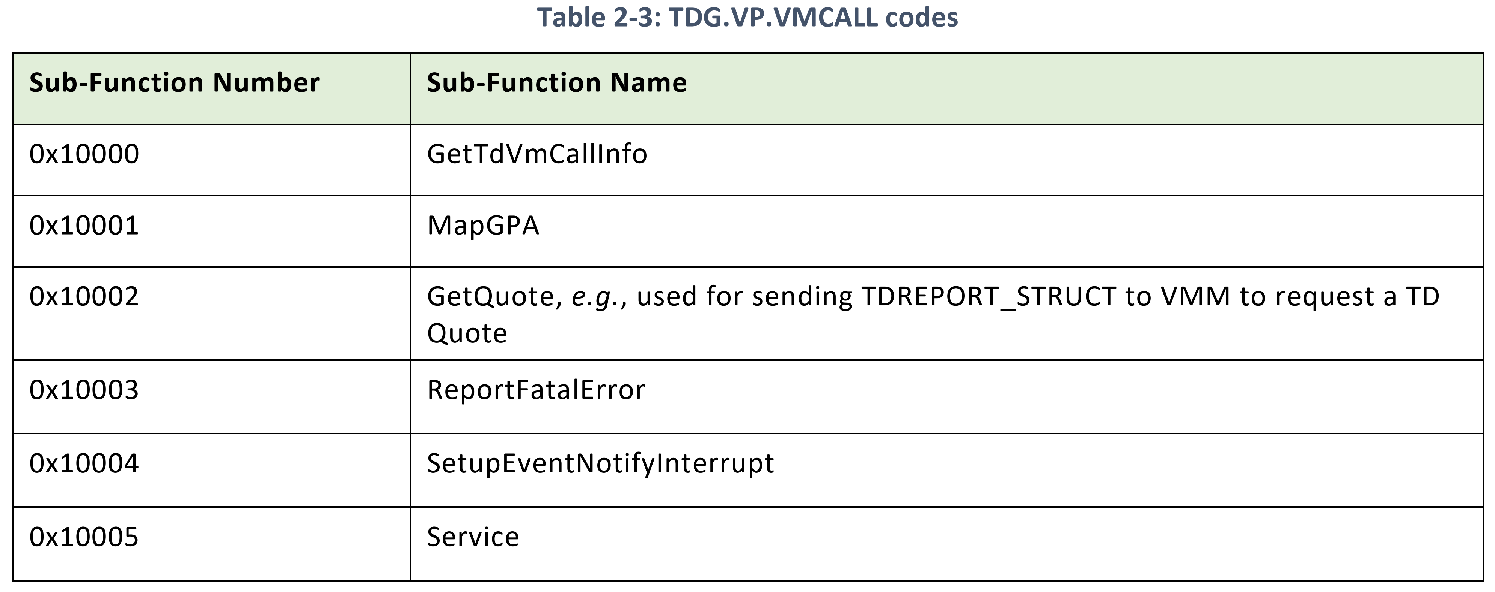
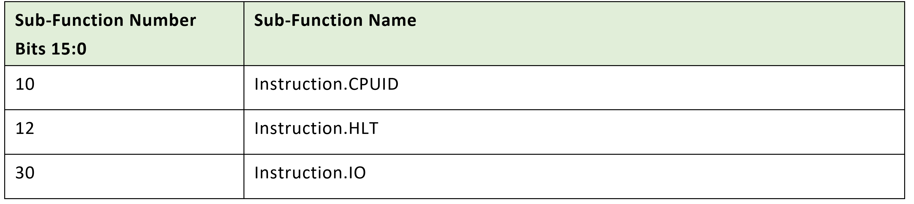
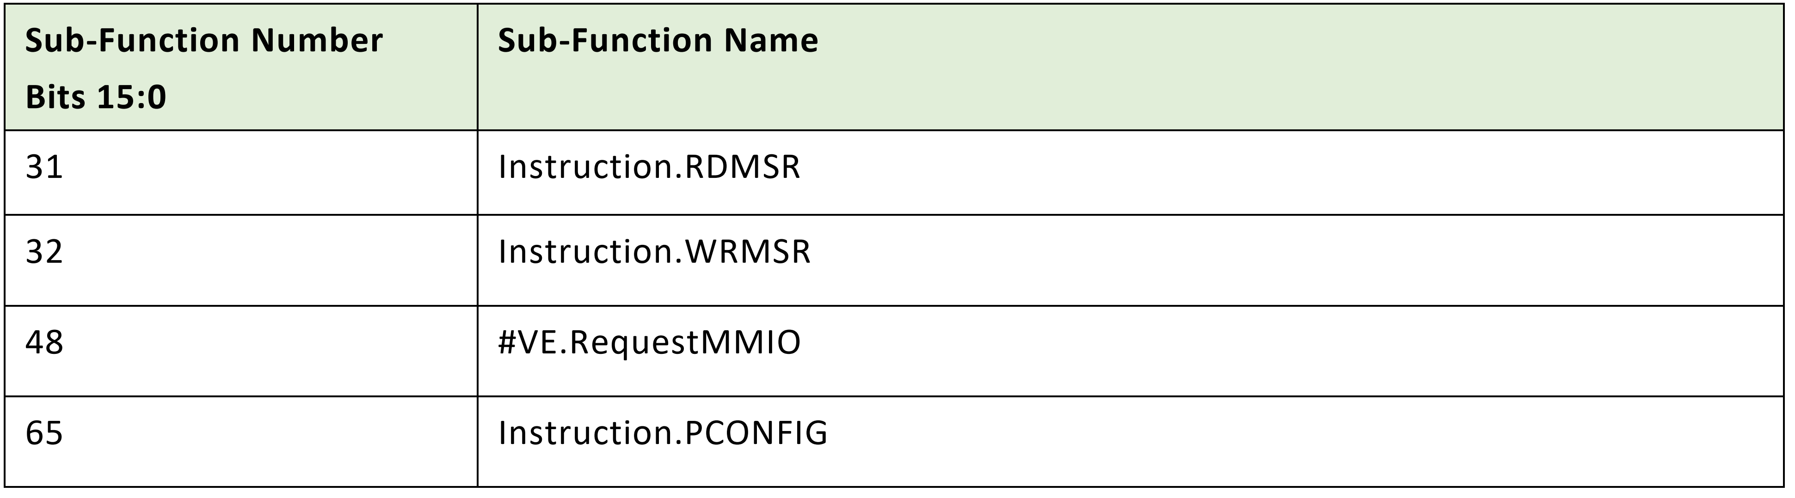
Possible services provided by VM through TDCALL

Slide 62
TDG.VP.VMALL examples
﻿GetTdVmCallInfo TDG.VP.VMCALL is used to help request the host VMM enumerate which TDG.VP.VMCALLs are supported.
This leaf is reserved for enumerating capabilities defined in this specification.
VMMs may provide alternate, enumeration schemes using vendor-specific, TDG.VP.VMCALL namespace

Slide 63
TDG.VP.VMALL examples - MapGPA
﻿Request the host VMM to map a GPA range as private- or shared-memory mappings
This API may also be used to convert page mappings from private to shared. ﻿For example, to exchange data with the VMM, the TD may use this TDG.VP.VMCALL to request that a GPA range be mapped as a shared memory (for example, for paravirtualized IO) via the shared EPT.
When the VMM responds to this TDG.VP.VMCALL with success, the goal is for the TD to execute TDCALL[TDG.MEM.PAGE.ACCEPT] to complete the process to make the page(s) usable as a private GPA inside the TD
﻿Upon MapGPA from shared to private, the VMM needs to check if the page is mapped by the IOMMU page table. If direct I/O is already enabled and the page is mapped, MapGPA should fail. This is equivalent to removing a page from a (legacy) guest with direct I/O enabled; the pages need to be pinned there.

Slide 64
﻿ TDG.VP.VMCALL<SetupEventNotifyInterrupt>
﻿The guest TD may request the host VMM specify which interrupt vector to use as an event-notify vector.
This is designed as an untrusted operation; thus, the TD OS should be designed to not use the event notification for trusted operations.
Example of an operation that can use the event notify is the host VMM signaling a device removal to the TD, in response to which a TD may unload a device driver.
The host VMM should use SEAMCALL [TDWRVPS] leaf to inject an interrupt at the requested-interrupt vector into the TD via the posted-interrupt descriptor.

Slide 65
﻿TDG.VP.VMCALL<#VE.RequestMMIO>
Request the VMM perform emulated-MMIO-access operation. The VMM may emulate MMIO space in shared-GPA space.
The VMM can induce a #VE on these shared-GPA accesses by mapping shared GPAs with the suppress-VE bit cleared in the EPT Entries corresponding to these mappings.
In response to the #VE, the TD can use the TDCALL[TDG.VP.VEINFO.GET] to get the Virtualization-Exception-Information Fields (See Error! Reference source not found.) and validate that the #VE exit reason is 48 (EPT violation causing #VE).
After the TD software decodes the instruction causing the #VE locally and validating the accessed region and source of access, the TD may choose to use this TDG.VP.VMCALL to request MMIO read/write operations.
The VMM may emulate the access based on the inputs provided by the TD. However, note that, like other TDG.VP.VMCALLs, this TDCALL is designed as an untrusted operation and to be used for untrusted IO with other cryptographic protection for the TD data provided by the TD itself.

Slide 66
SEAMRET — Return to Legacy VMX Root Operation
This instruction helps the SEAM VMX root software exit from SEAM VMX root operation and resume execution of the VMM software in legacy VMX root operation
SEAMRET from the P-SEAMLDR clears the current VMCS structure pointed to by the current-VMCS pointer.
A VMM that invokes the P-SEAMLDR using SEAMCALL must reload the current-VMCS, if required, using the VMPTRLD instruction.

Slide 67
SEAMCALL — Call to SEAM VMX Root Operation
The SEAMCALL instruction uses RAX register bit 63 to determine if the request is to transition to the Intel PSEAMLDR module (acm backed) (if bit 63 is 1) or the Intel TDX module (if bit 63 is 0).
SEAMCALL invokes an indirect branch control mechanism that establishes a barrier, preventing software that executed before the SEAMCALL from controlling the predicted targets of indirect branches executed after SEAMCALL on the same logical processor

Slide 68
SEAMOPS — Invoke SEAM Operations
The SEAMOPS instruction is used to help execute SEAM-specific operations in SEAM VMX root operation.
Two leaf functions are currently defined:
CAPABILITIES (RAX == 0): Returns a bitmap of the supported SEAMOPS leaves.
SEAMREPORT (RAX == 1): Generate SEAMREPORT structure.

Slide 69
Possible research directions?
What happens if the attacker can compromise one of the TD and VMM? Can compromised TD instance affect other TD vm by cooperating with VMM? TDX does not trust the VMM but it doesn’t assume that one of the TD is compromised. Is there some security hole in the ABI? VMM <-> TDX <->TD? (Usually TDX assumes VMM is compromised and TDX is bug free.. But what about TD?)
TD has been designed with no deterministic way to confirm the result of those operations performed by the host VMM. How each TD can verify and assure that VMM faithfully service their request?

Slide 70
Possible research directions?
AMD SEV-snp and Intel TDX provide similar functionalities, but not compatible. Is it possible to emulate AME SEV on Intel TDX or vice versa? Similar to emulating SGX capabilities on AMD processor?
TDX provides ﻿array of registers extended at runtime similar to TPM PCR. How to utilize this registers to store important system changes made to TD? Can we detect EPT based side channels using a runtime attestation? TDX reports some unexceptional events, can we memorize those events as runtime attestation?
How to establish fast and secure IO devices connection from TD? should it be always be offloaded to shared pages ..?

Slide 71
Possible research directions?
MKTME, Intel SGX, AMD SEV.. Use all different encryption and MAC. Can we offload this encryption and integrity checks to Processor In memory? Also CXL provides the Link layer encryption (PCI-E encryption)

